Slide 1
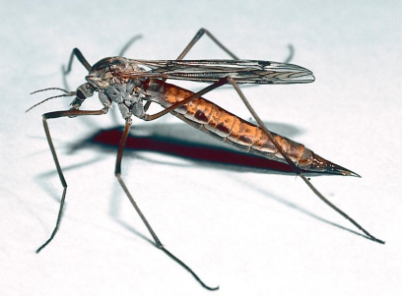
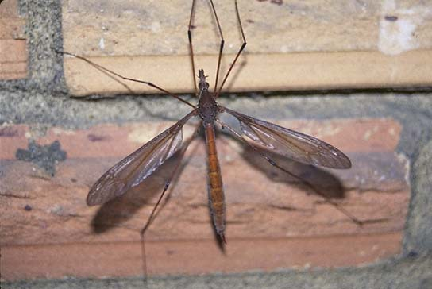
035 Crane fly
Diptera
Holometabolous
Piercing-sucking
Variable (Beneficial and Pest)

Slide 2
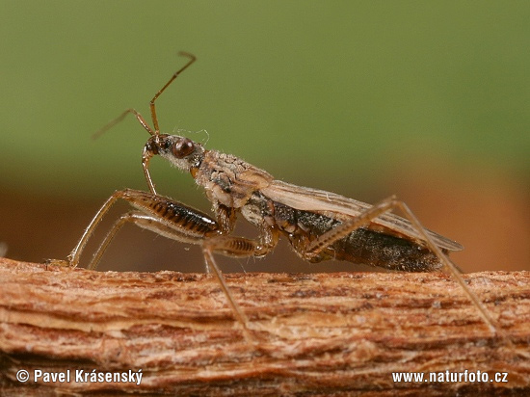
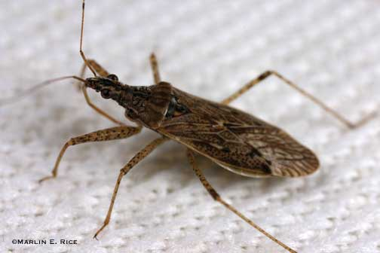
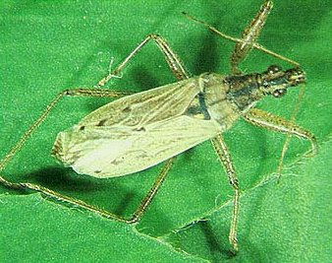
036 Damsel bug
Hemiptera
Hemimetabolous
Piercing-sucking
Beneficial

Slide 3
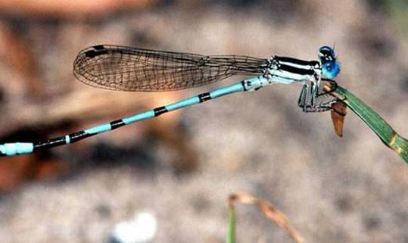
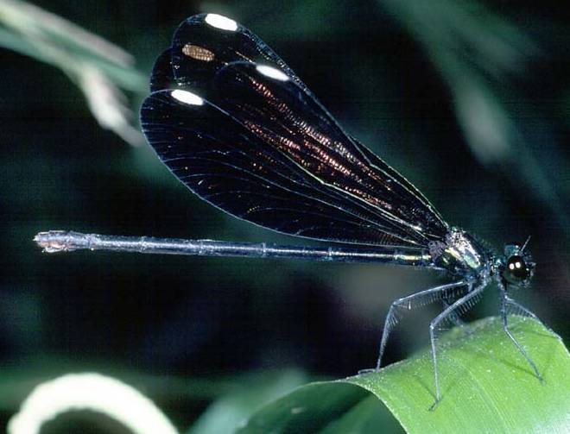
037 Damselfly
Odonata
Hemimetabolous
Chewing
Beneficial

Slide 4
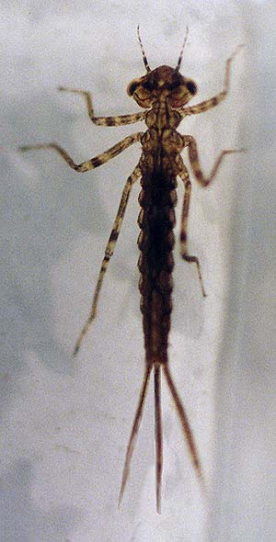
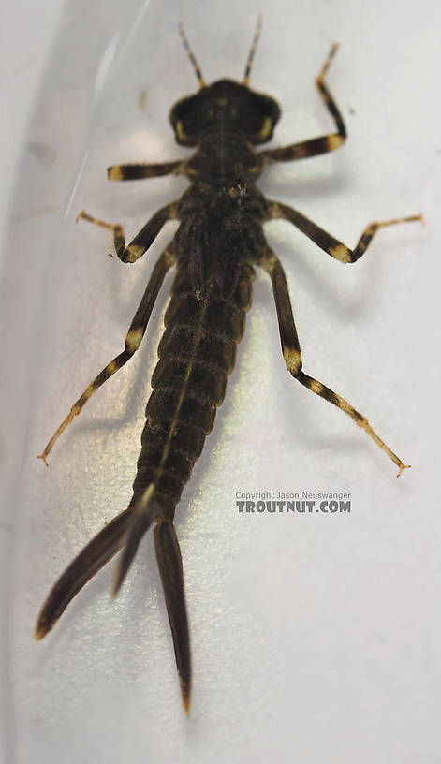
038 Damselfly nymph
Odonata
Hemimetabolous
Chewing
Beneficial

Slide 5
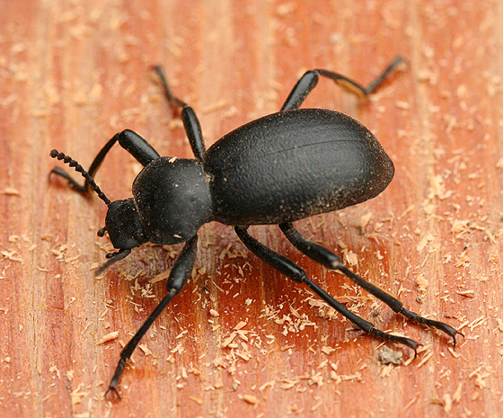
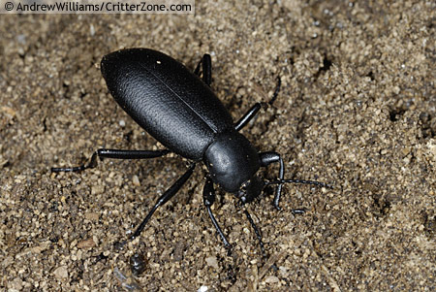
039 Darkling beetle
Coleoptera
Holometabolous
Chewing
Variable (Beneficial and Pest)

Slide 6
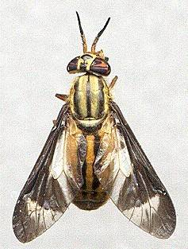
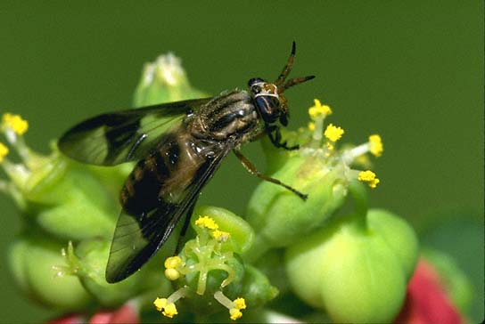
040 Deer fly
Diptera
Holometabolous
Cutting-sponging
Pest

Slide 7
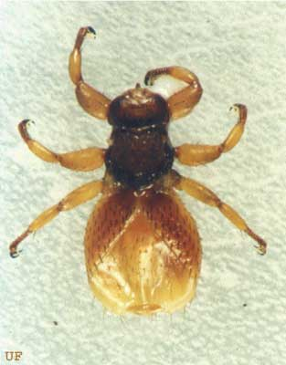
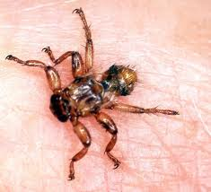
041 Deer ked
Diptera
Holometabolous
Piercing-sucking
Pest

Slide 8
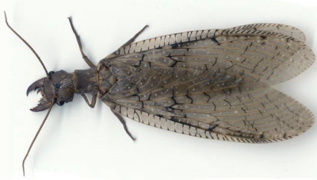
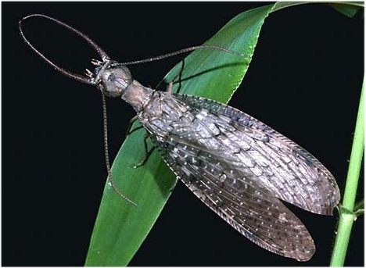
041 Dobsonfly
Neuroptera
Holometabolous
Chewing
Beneficial

Slide 9
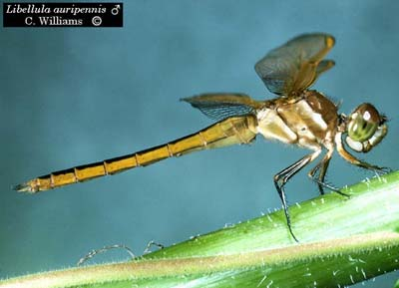
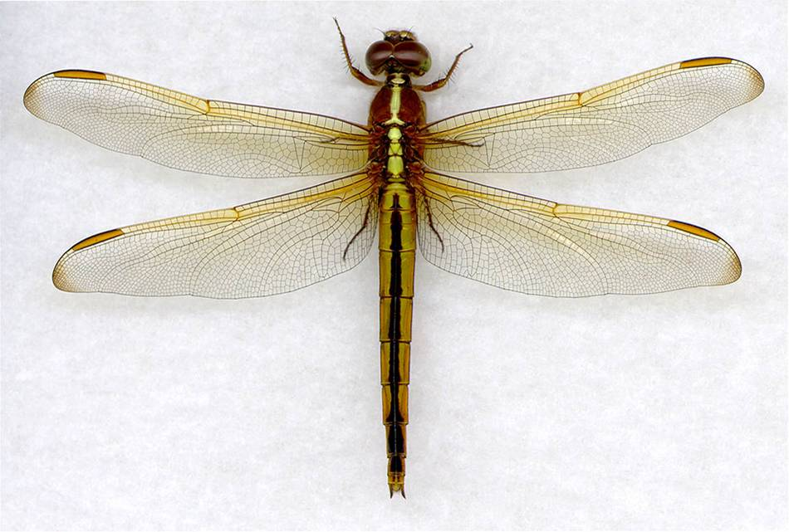
043 Dragonfly
Odonata
Hemimetabolous
Chewing
Beneficial

Slide 10
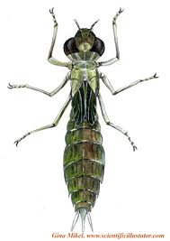
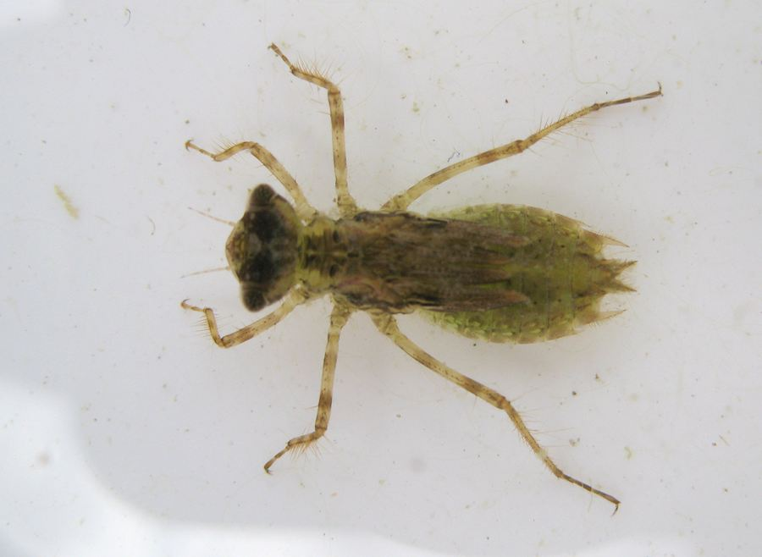
044 Dragonfly nymph
Odonata
Hemimetabolous
Chewing
Beneficial

Slide 11
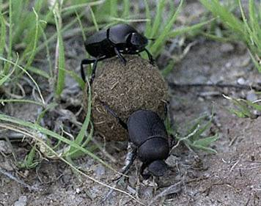
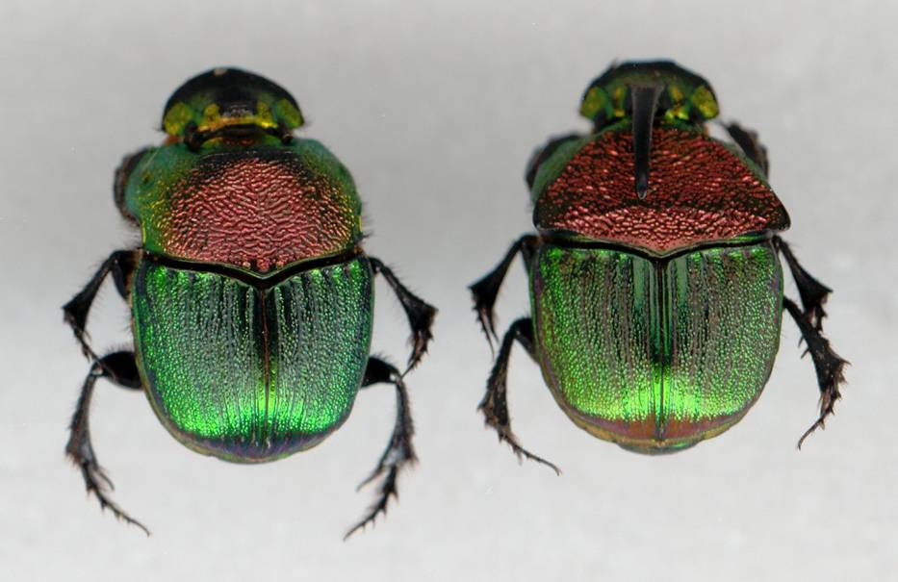
045 Dung beetle
Coleoptera
Holometabolous
Chewing
Beneficial

Slide 12
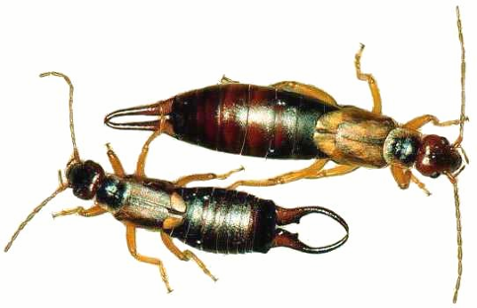
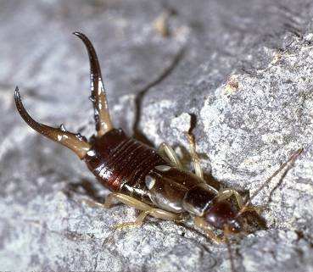
046 Earwig
Dermaptera
Hemimetabolous
Chewing
Beneficial

Slide 13
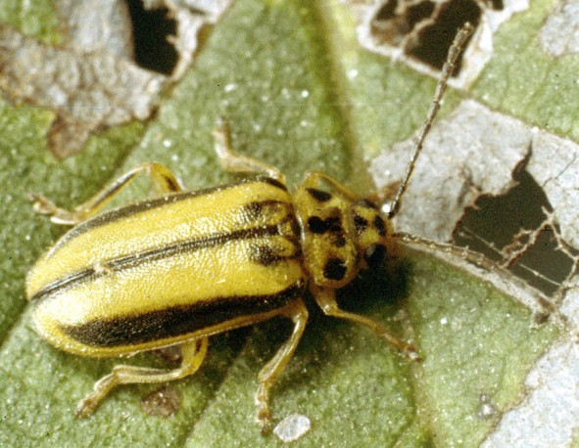
047 Elm leaf beetle
Coleoptera
Holometabolous
Chewing
Pest

Slide 14
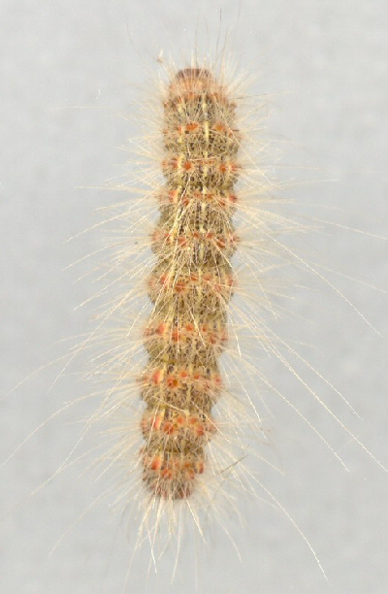
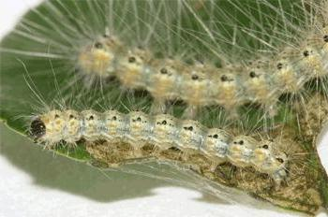
048 Fall webworm
Lepidoptera
Holometabolous
Chewing
Pest

Slide 15
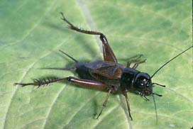
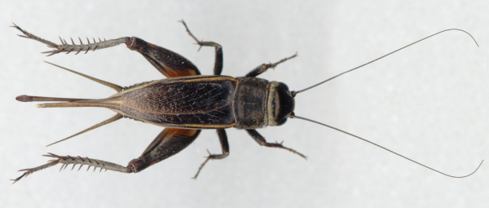
049 Field cricket
Orthoptera
Hemimetabolous
Chewing
Pest

Slide 16
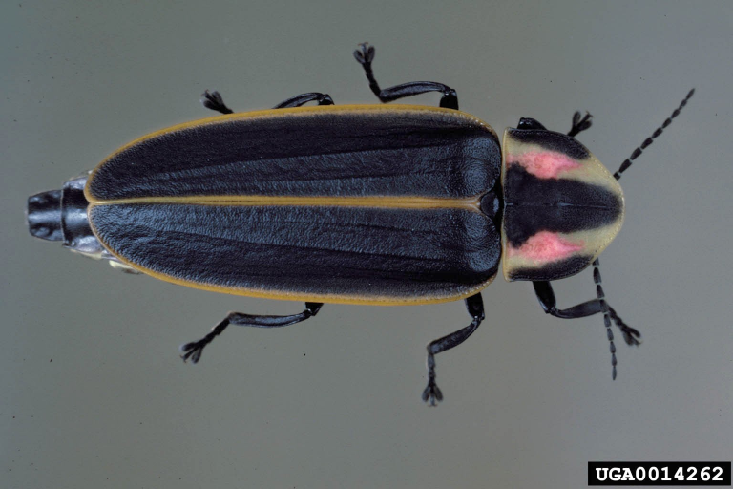
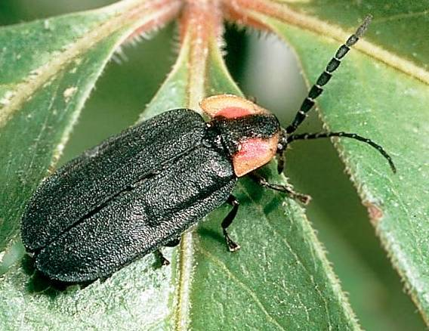
050 Firefly
Coleoptera
Holometabolous
Chewing
Beneficial

Slide 17
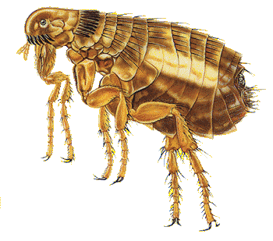
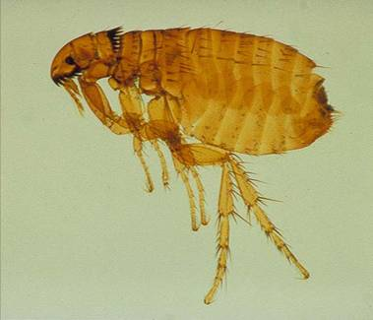
051 Flea
Siphonaptera
Holometabolous
Piercing-sucking
Pest

Slide 18
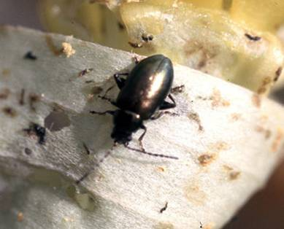
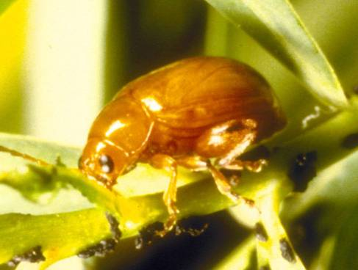
052 Flea beetle
Coleoptera
Holometabolous
Chewing
Pest

Slide 19
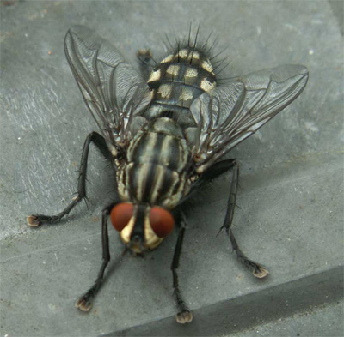
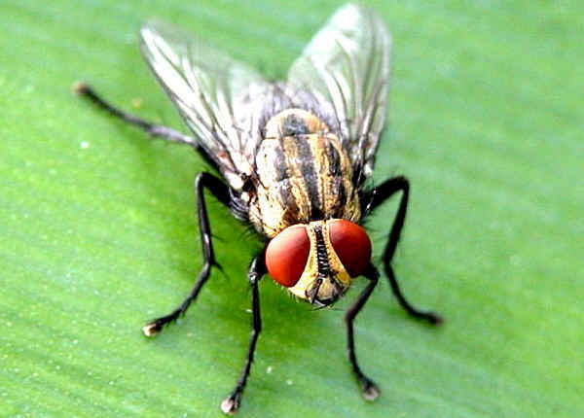
053 Flesh fly
Diptera
Holometabolous
Sponging
Pest

Slide 20
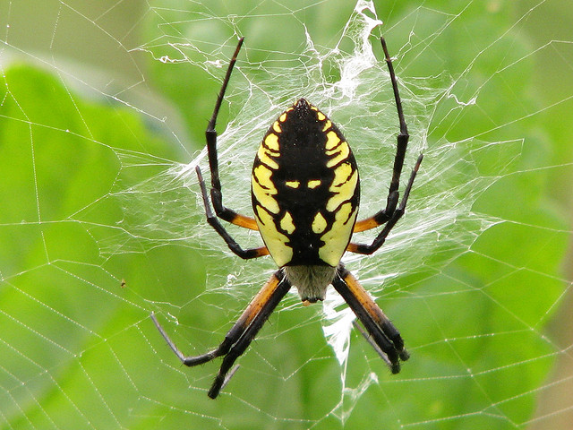
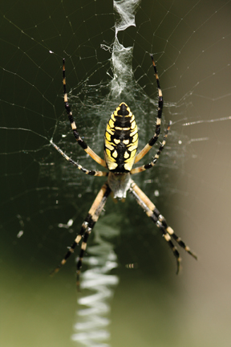
054 Garden spider
Non-insect
Beneficial

