Slide 1
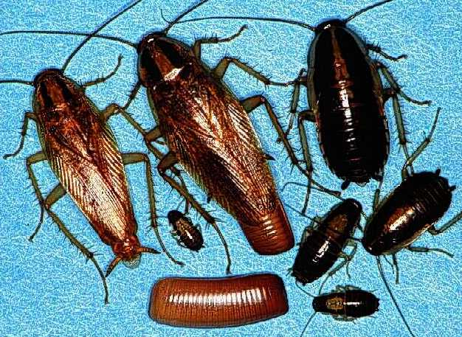
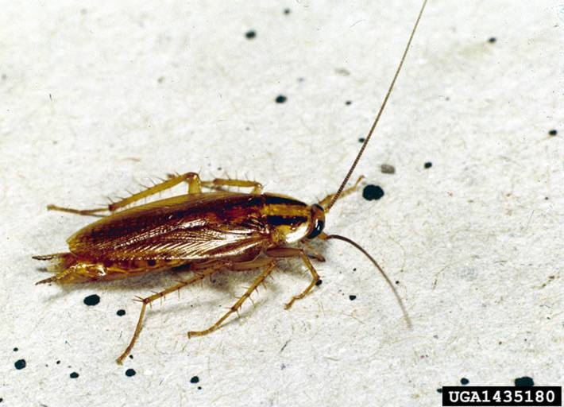
055 German cockroach
Blattodea
Hemimetabolous
Chewing
Pest
Notice Lines on Thorax

Slide 2
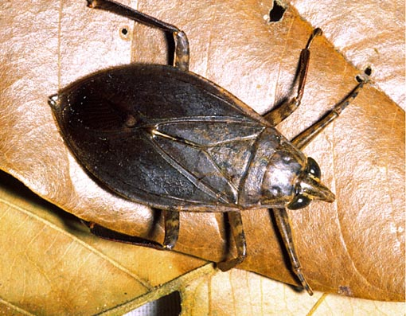
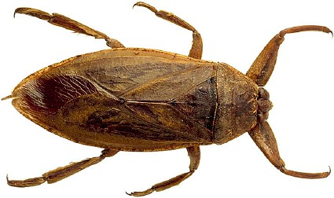
056 Giant water bug
Hemiptera
Hemimetabolous
Piercing-sucking
Beneficial

Slide 3
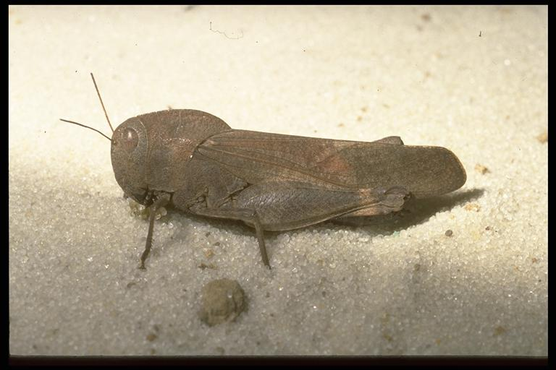
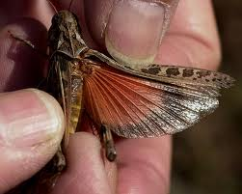
057 Banded winged grasshopper
Orthoptera
Hemimetabolous
Chewing
Pest

Slide 4
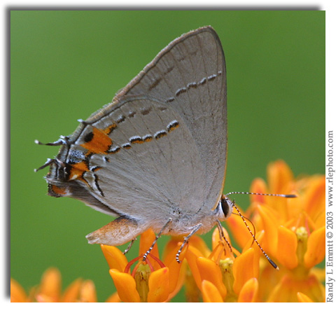
058 Gray hairstreak
Lepidoptera
Holometabolous
Siphoning
Pest

Slide 5
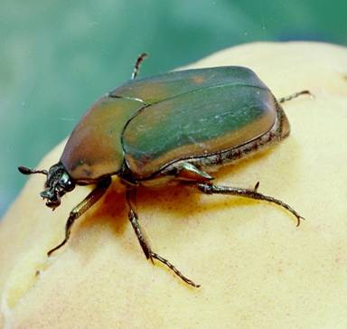
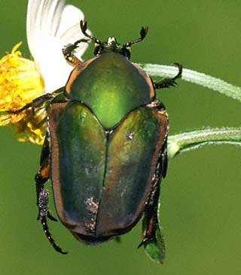
059 Green June beetle
Coleoptera
Holometabolous
Chewing
Pest

Slide 6
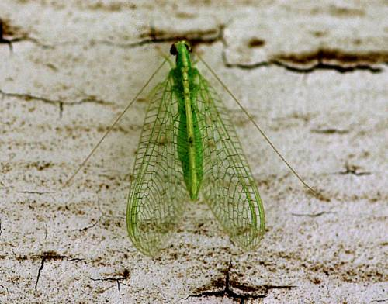
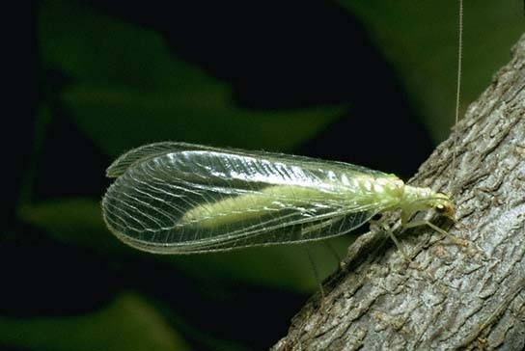
060 Green lace wing
Neuroptera
Holometabolous
Chewing
Beneficial

Slide 7
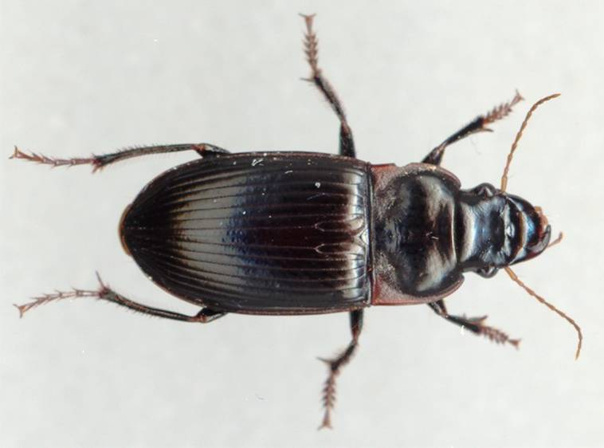
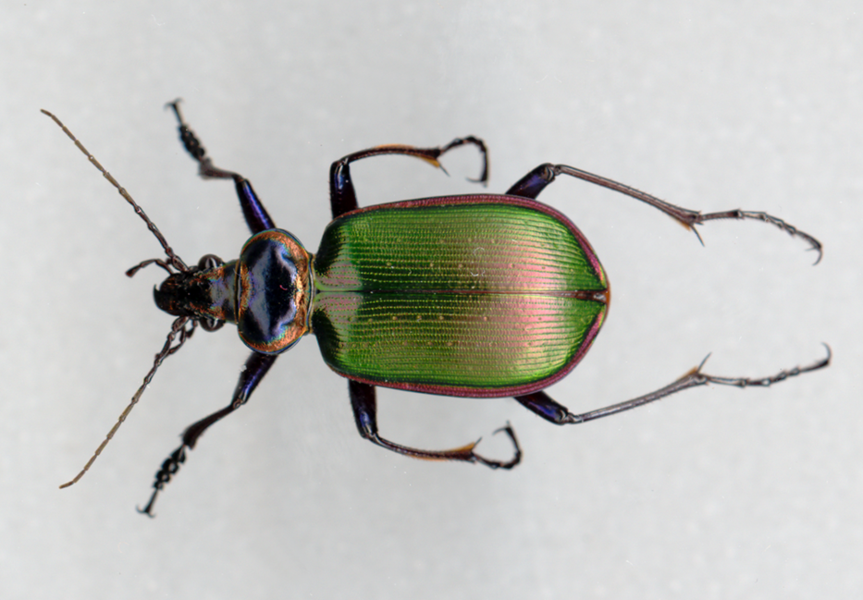
061 Ground beetle
Coleoptera
Holometabolous
Chewing
Beneficial

Slide 8
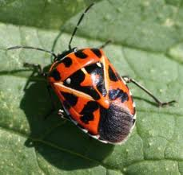
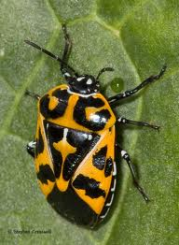
062 Harlequin bug
Hemiptera
Hemimetabolous
Piercing-sucking
Pest

Slide 9
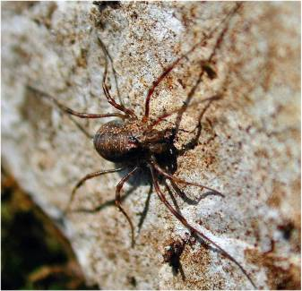
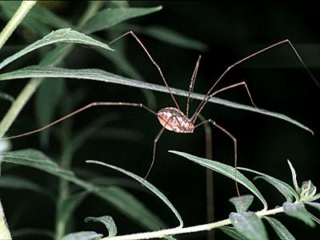
063 Harvestman
Non-insect
Variable (Beneficial and Pest)

Slide 10
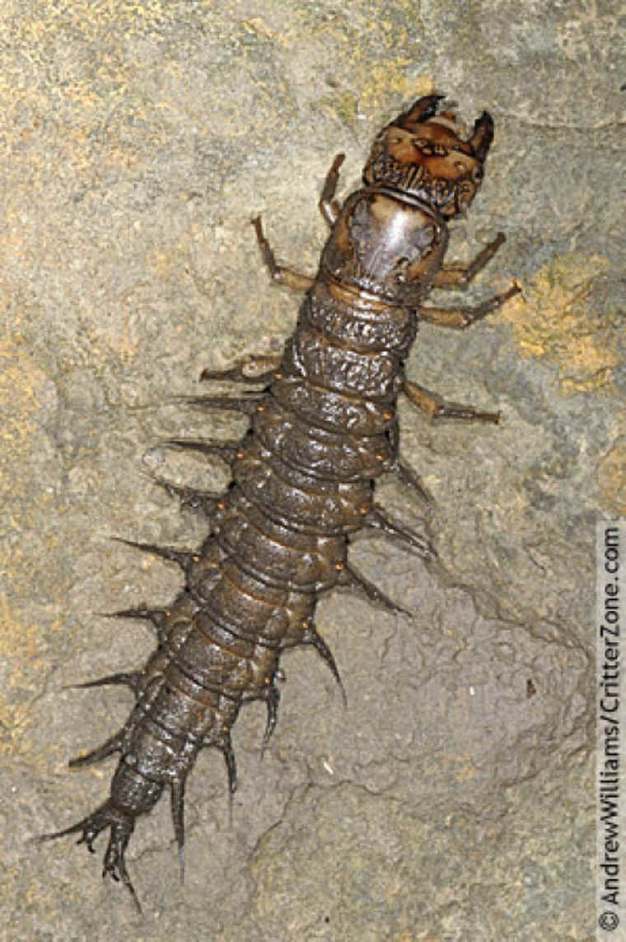
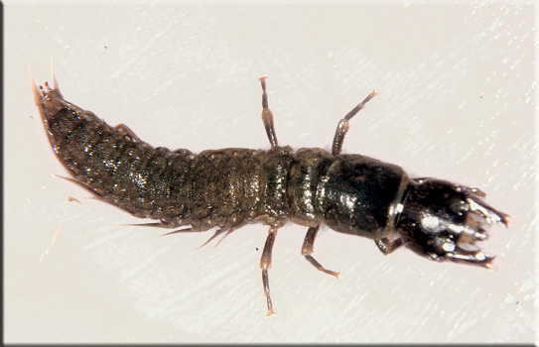
064 Hellgrammite
Neuroptera
Holometabolous
Chewing
Beneficial

Slide 11
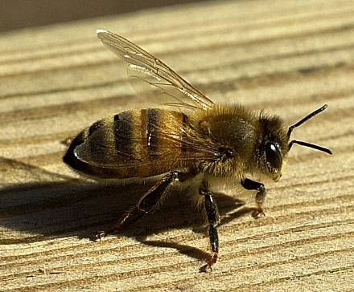
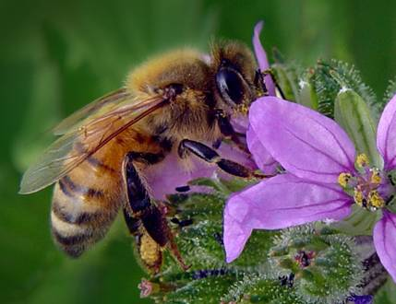
065 Honey bee
Hymenoptera
Holometabolous
Chewing-lapping
Beneficial

Slide 12
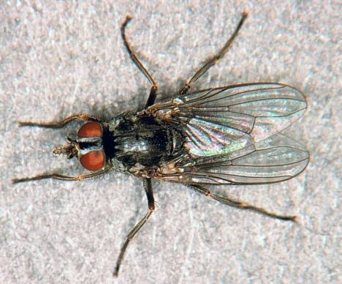
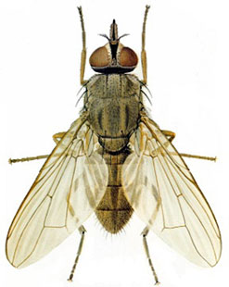
066 Horn fly
Diptera
Holometabolous
Cutting-lapping
Pest

Slide 13
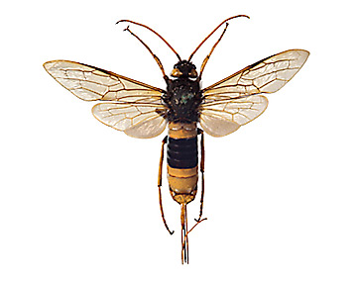
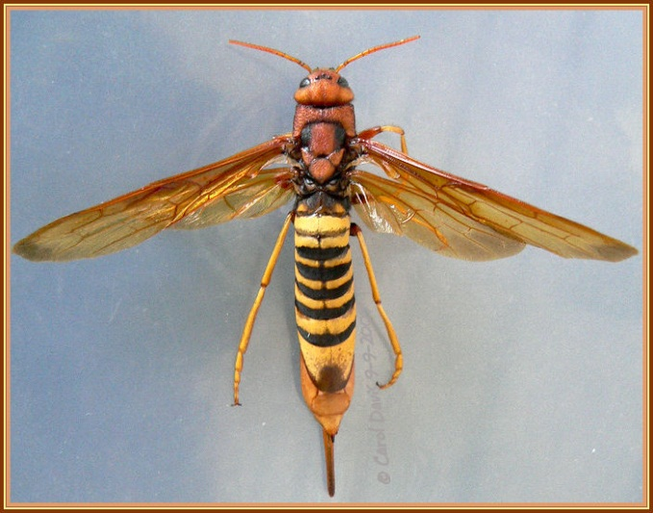
067 Horntail wasp
Hymenoptera
Holometabolous
Chewing
Pest

Slide 14
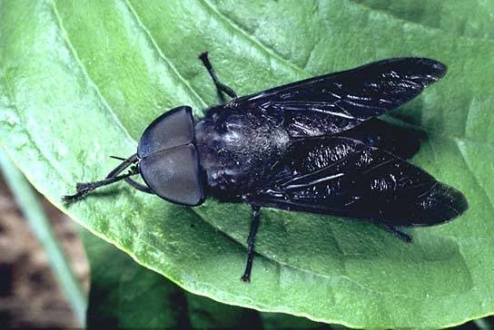
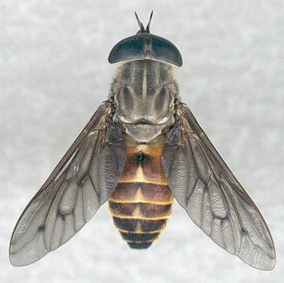
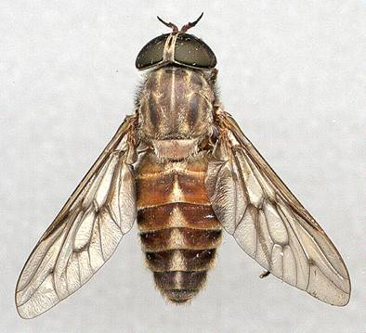
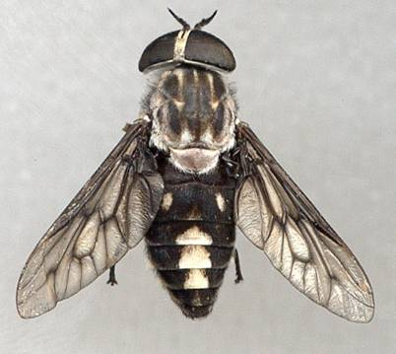
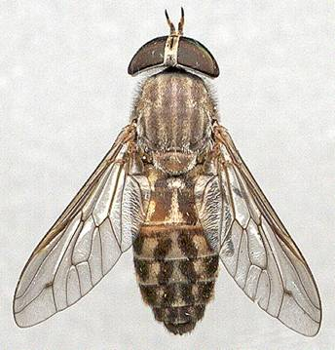
068 Horse fly
Diptera
Holometabolous
Ctting-sponging
Pest

Slide 15
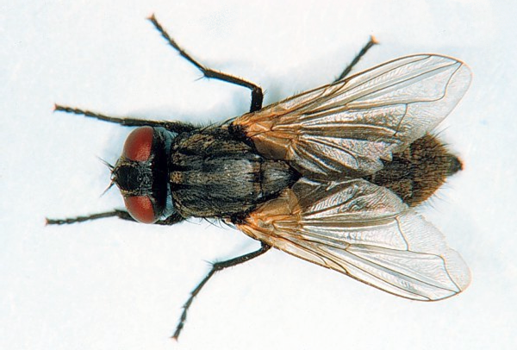
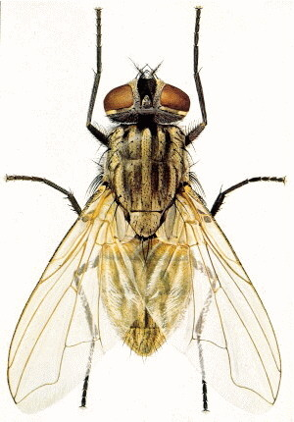
069 House fly
Diptera
Holometabolous
Sponging
Pest

Slide 16
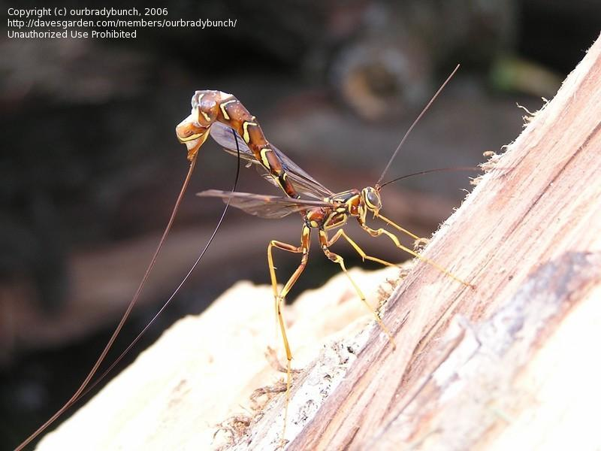
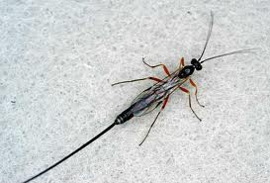
070 Ichneumon wasp
Hymenoptera
Holometabolous
Chewing
Beneficial

Slide 17
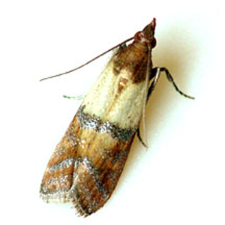
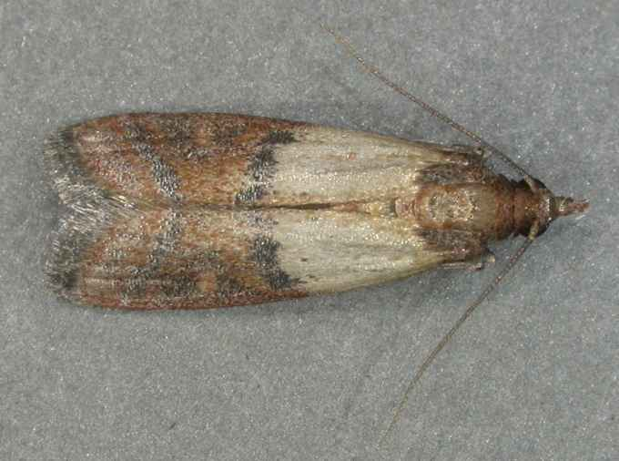
071 Indian meal moth
Lepidoptera
Holometabolous
Siphoning
Pest

Slide 18
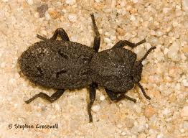
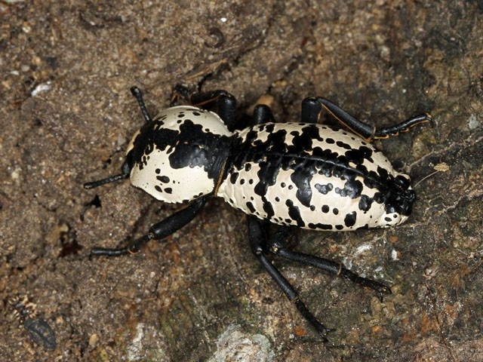
072 Ironclad beetle
Coleoptera
Holometabolous
Chewing
Variable (Beneficial and Pest)

Slide 19
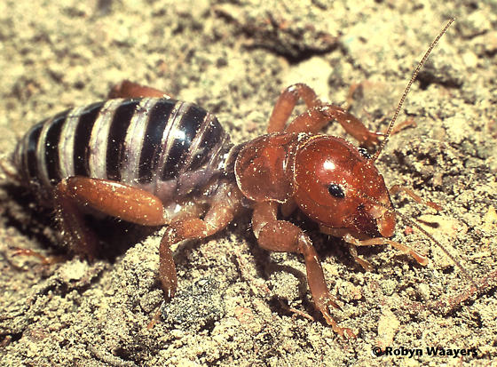
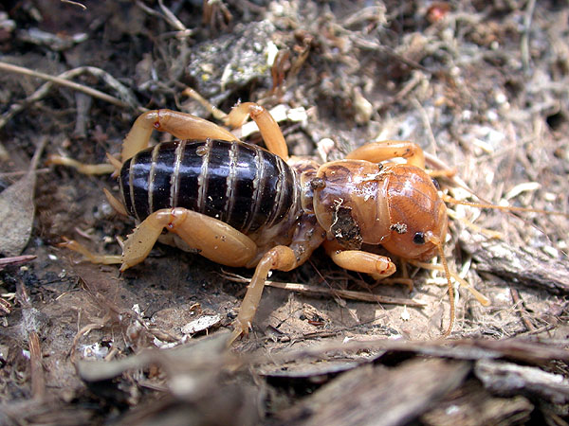
073 Jerusalem cricket
Orthoptera
Hemimetabolous
Chewing
Variable

Slide 20
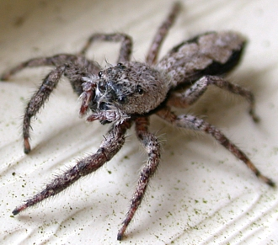
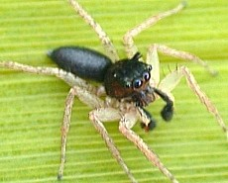
074 Jumping spider
Look for the eyes
Bon-insect
Beneficial

