Slide 1
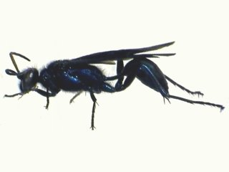
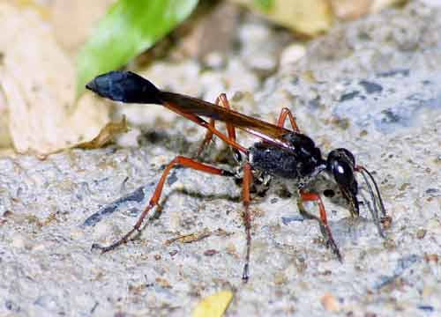
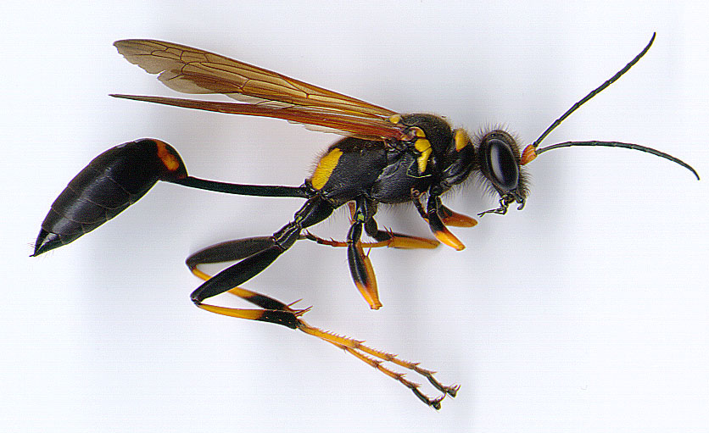
095 Mud-dauber wasp
Hymenoptera
Holometabolous
Chewing
Variable

Slide 2
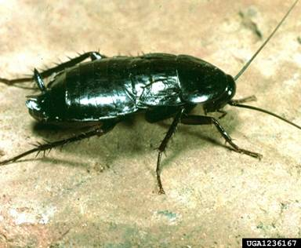
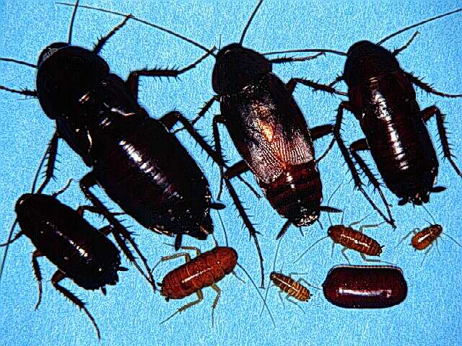
096 Oriental cockroach
Blattodea
Hemimetabolous
Chewing
Pest

Slide 3
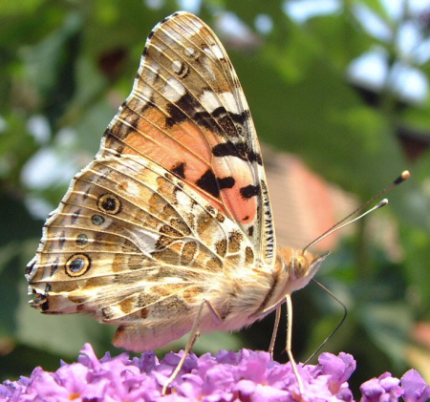
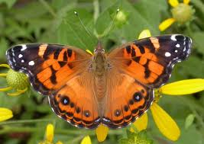
097 Painted lady
Lepidoptera
Holometabolous
Siphoning
Beneficial

Slide 4
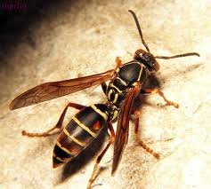
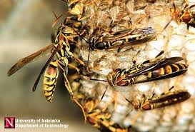
098 Paper wasp
Hymenoptera
Holometabolous
Chewing
Variable (Pest and Beneficial)

Slide 5
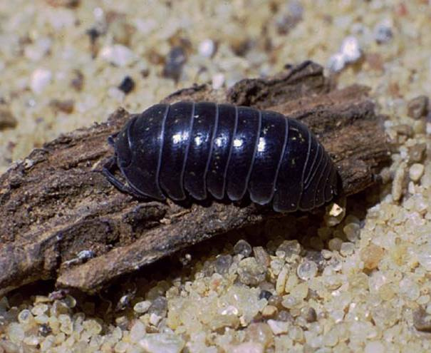
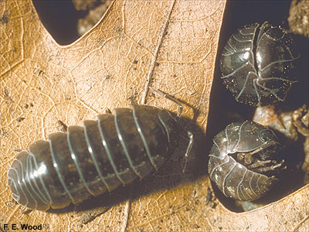
099 Pillbug
Non-insect
Chewing
Variable (Pest and Beneficial)

Slide 6
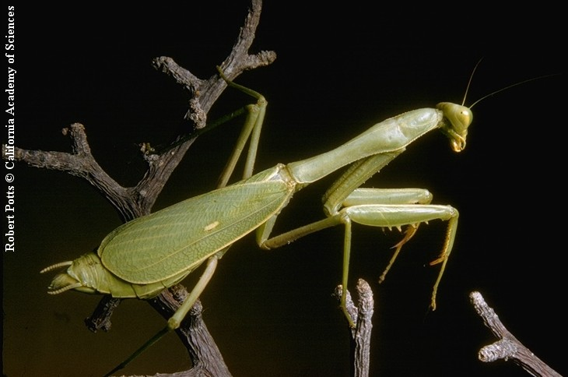
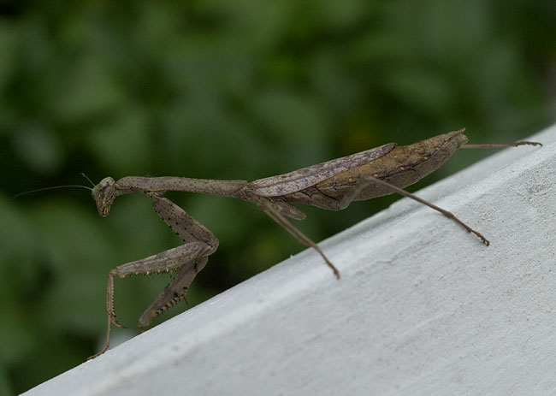
100 Praying mantis
Mantodea
Hemimetabolous
Chewing
Beneficial

Slide 7
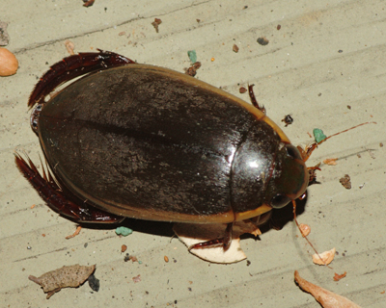
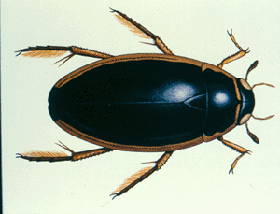
101 Predaceous diving beetle
Coleoptera
Holometabolous
Chewing
Beneficial

Slide 8
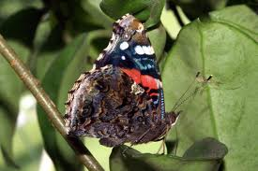
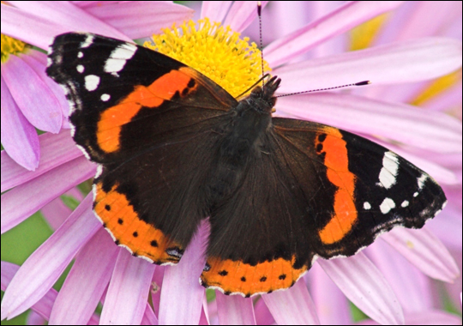
102 Red admiral
Lepidoptera
Holometabolous
Siphoning
Beneficial

Slide 9
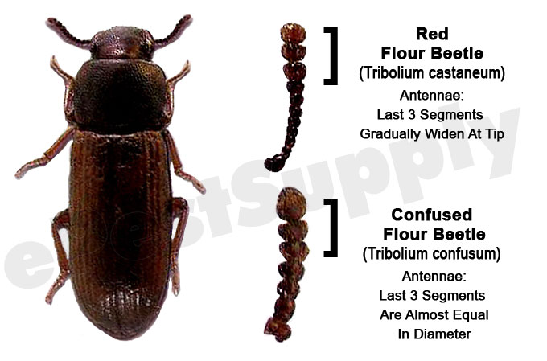
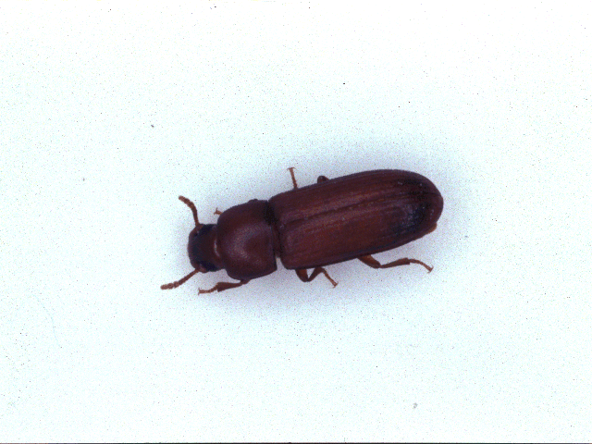
103 Red flour beetle
Coleoptera
Holometabolous
Chewing
Pest

Slide 10
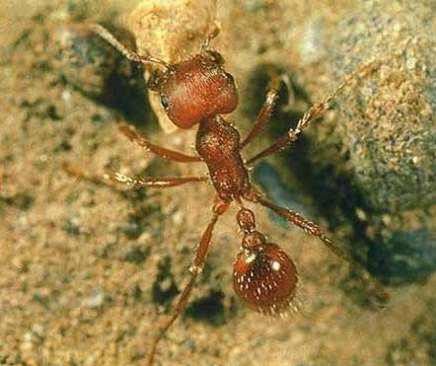
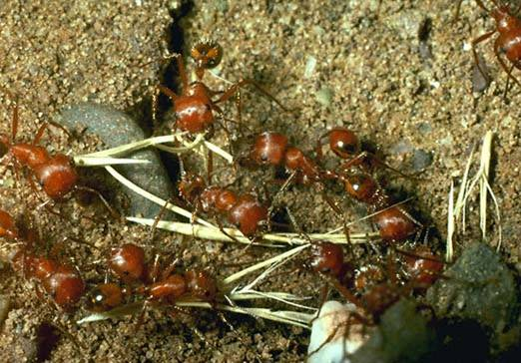
104 Red harvester ant
Hymenoptera
Holometablous
Chewing
Pest

Slide 11
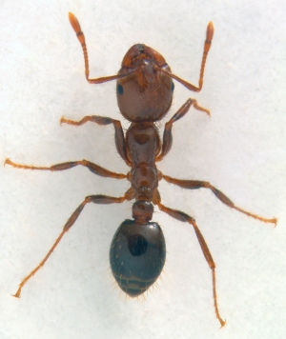
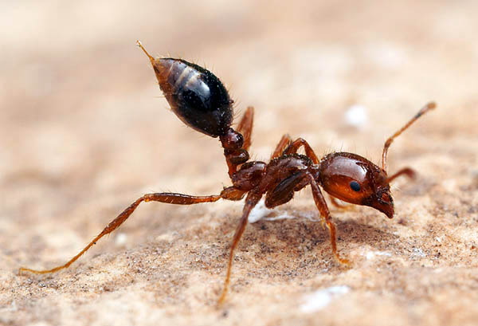
105 Red imported fire ant
Hymenoptera
Holometablous
Chewing
Pest

Slide 12
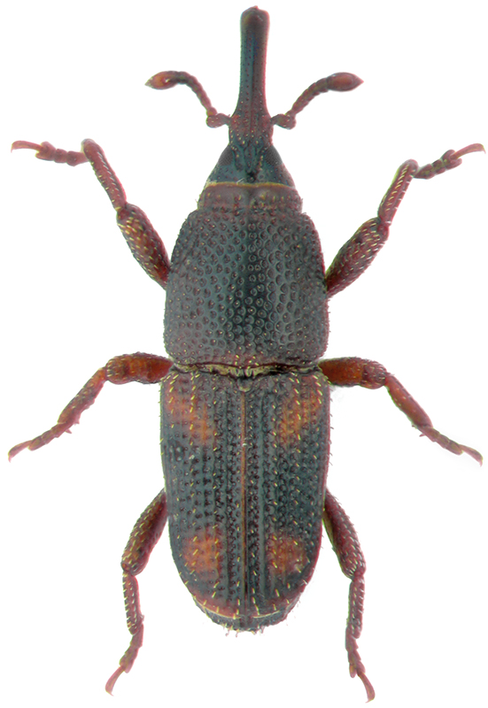
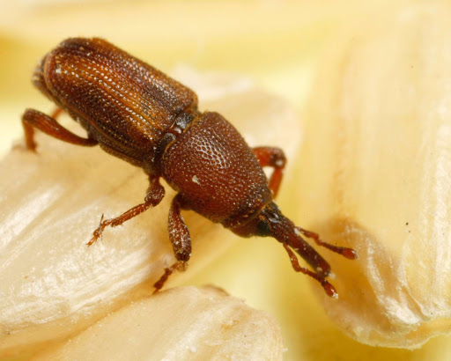
106 Rice Weevil
Coleoptera
Holometabolous
Chewing
Pest

Slide 13
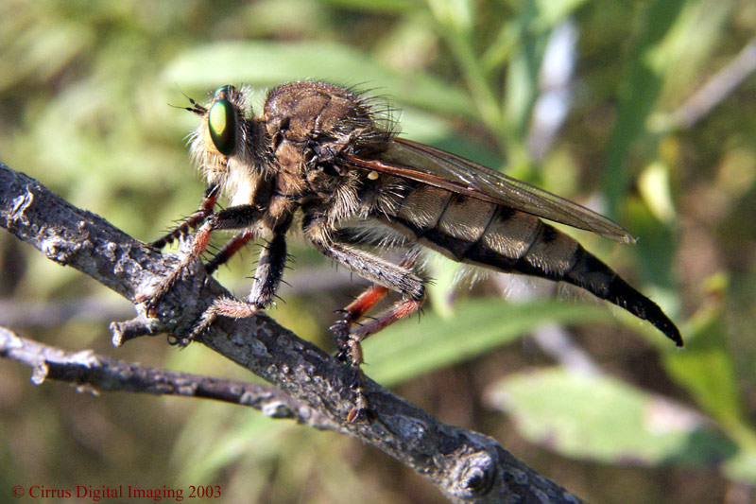
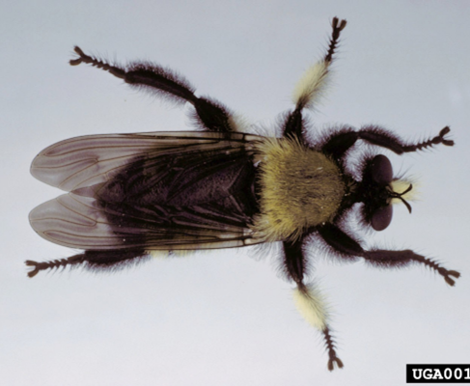
107 Robber fly
Diptera
Holometabolous
Piercing-sucking
Beneficial

Slide 14
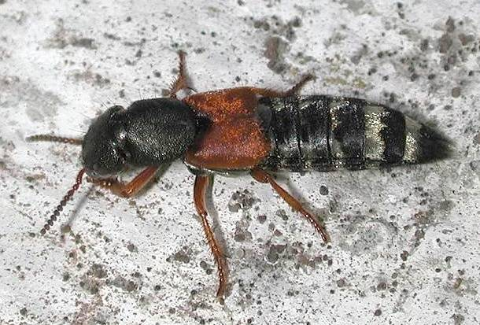
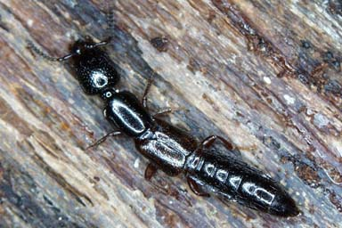
108 Rove beetle
Coleoptera
Holometabolous
Chewing
Beneficial

Slide 15
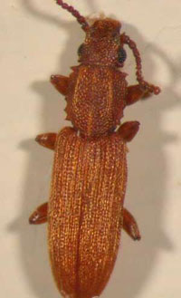
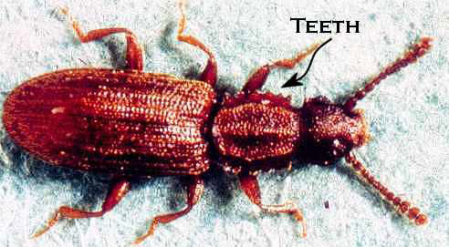
109 Sawtoothed grain beetle
Coleoptera
Holometabolous
Chewing
Pest
Note Jagged Edged Thorax

Slide 16
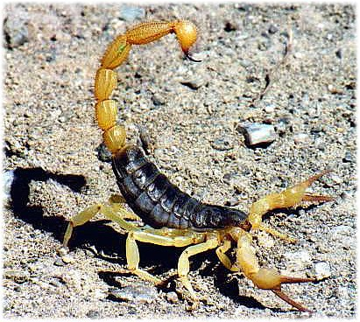
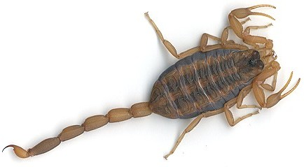
110 Scorpion
Non-insect
Pest

Slide 17
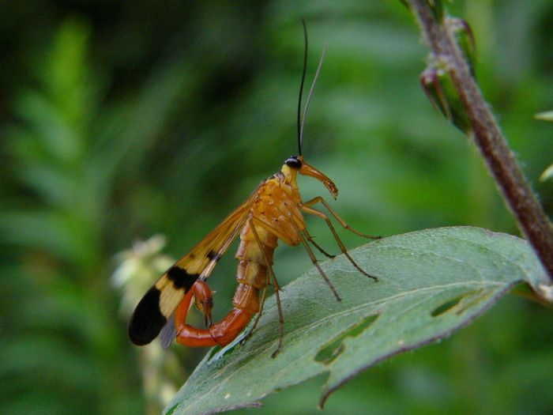
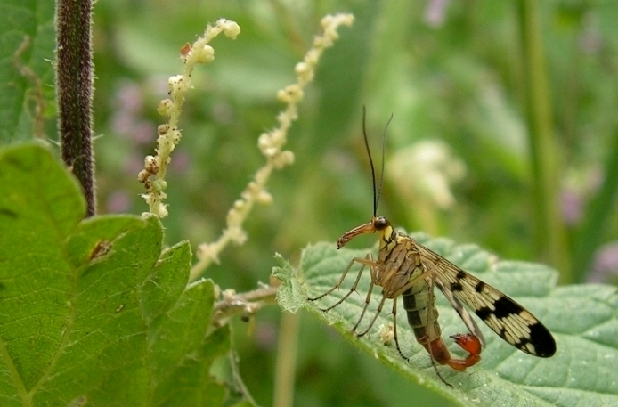
111 Scorpionfly
Mecoptera
Holometabolous
Chewing
Beneficial

Slide 18
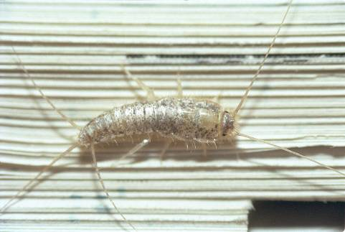
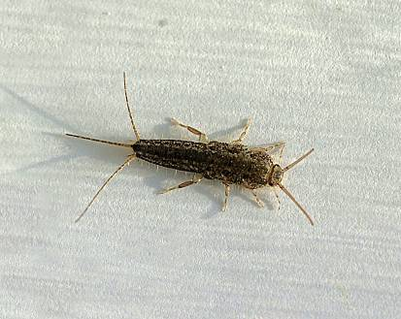
112 Silverfish
Thysanura
Ametabolous
Chewing
Pest

Slide 19
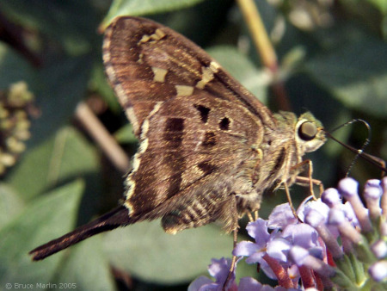
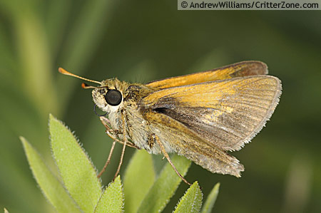
113 Skipper butterfly
Lepidoptera
Holometabolous
Siphoning
Variable (Pest and Beneficial)
Notice the Large Eyes

Slide 20
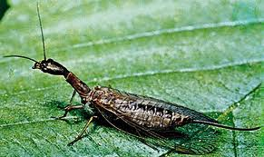
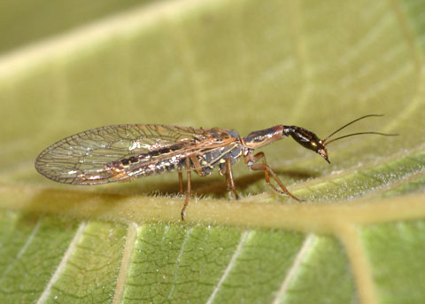
114 Snakefly
Neuroptera
Holometabolous
Chewing
Beneficial

