Slide 1
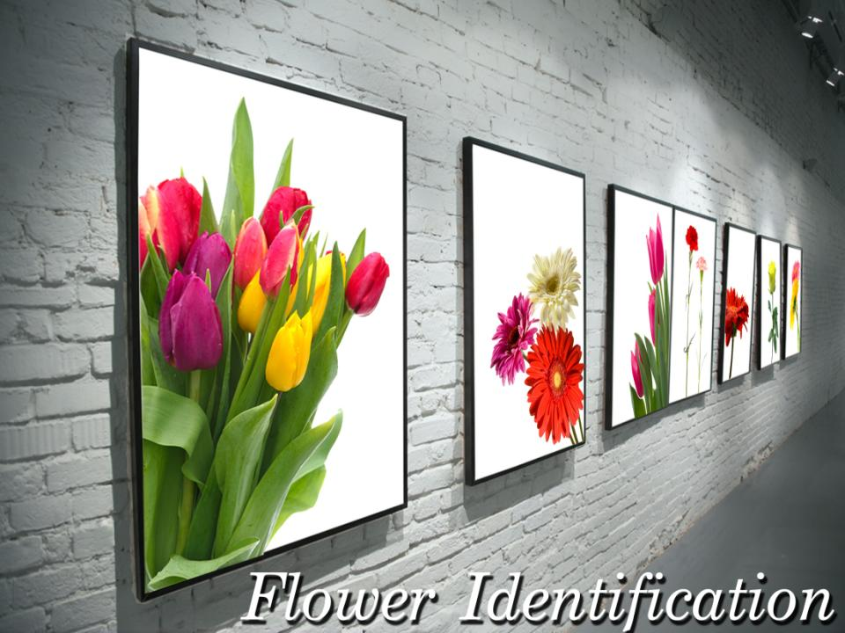

Slide 2
Objectives
To identify flowers and other floral materials.
To discover the botanical and common names of flowers and other floral materials.
To analyze flower characteristics.

Slide 3
Main Menu
Line Flowers
Mass Flowers
Form Flowers
Filler Flowers
Foliage & Greenery
Potted Plants

Slide 4
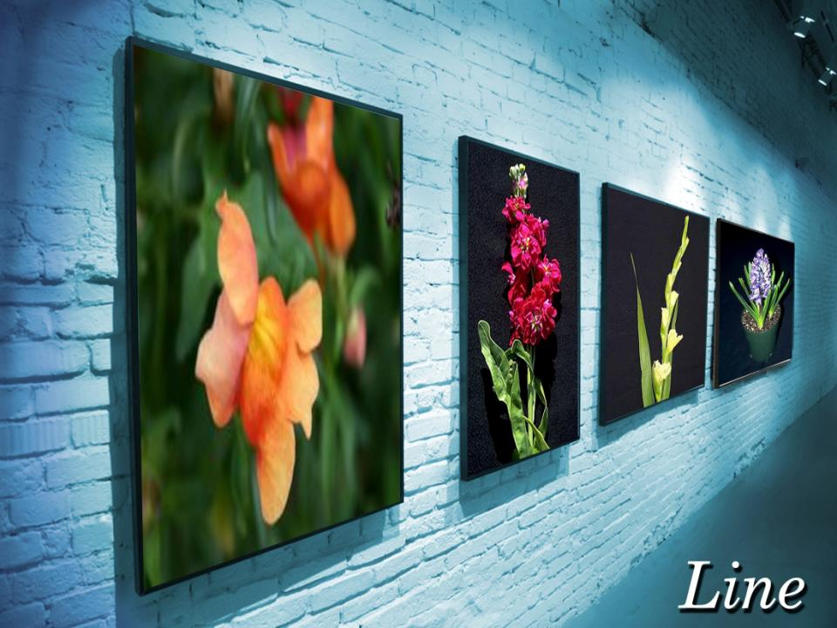
Return to
Main Menu

Slide 5
Line Flowers
Are used as primary flowers to establish the skeleton outline height or width of an arrangement

Slide 6
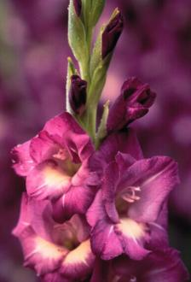
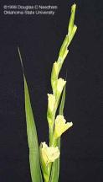
Garden Gladiolus
Botanical name: Gladiolus x hortulanus cv.
Origin: Africa
Color: white, pink, salmon, yellow, orange, red, green and violet

Slide 7
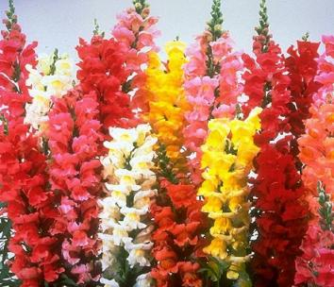
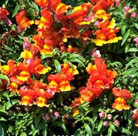
Snapdragon
Botanical name: Antirrhinum majus cv.
Origin: Mediterranean region and Iberian Peninsula
Color: commonly yellow, pink and white; occasionally dark pink, red, bronze or lavender

Slide 8
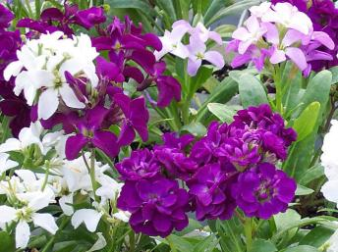
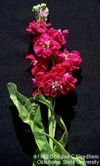
Flowering Stock
Botanical name: Matthiola incana cv.
Origin: North America
Color: white, red, lavender and yellow

Slide 9
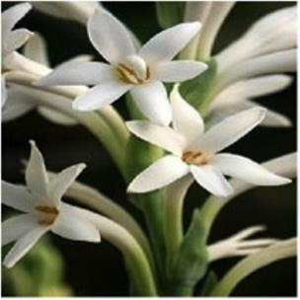
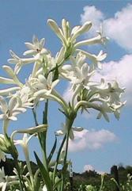
Tuberose
Botanical name: Polianthes tuberosa
Origin: Mexico
Color: white

Slide 10
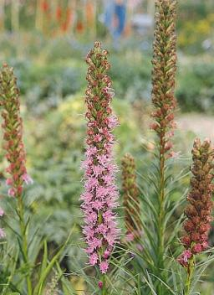
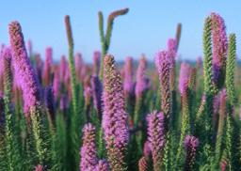
Liatris
Botanical name: Liatris spicata
Origin: North America, Mexico and the Bahamas
Color: shades of purple

Slide 11
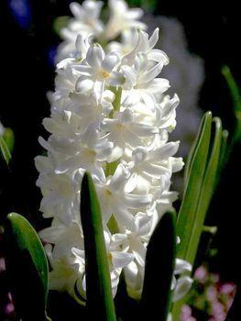
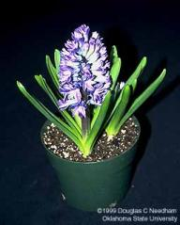
Hyacinth
Return to
Main Menu
Botanical name: Hyacinthus orientalis cv.
Origin: southwestern Asia, central and southern Turkey, northwestern Syria, Lebanon and northern Israel
Color: purple, orange, pink, white and red

Slide 12
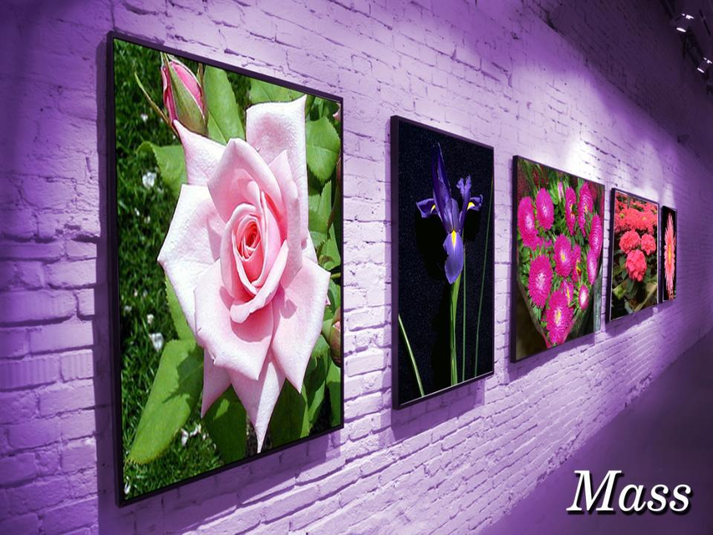
Return to
Main Menu

Slide 13
Mass Flowers
Are usually single stem with large rounded heads used inside or along the arrangement to fill in

Slide 14
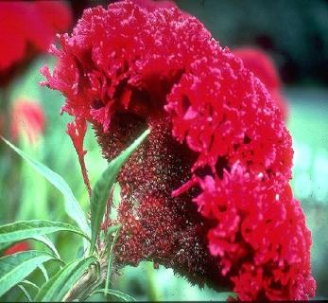
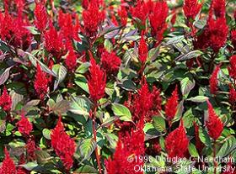
Cockscomb
Botanical name: Celosia argentea cv.
Origin: tropics
Color: crimson, maroon and purple

Slide 15
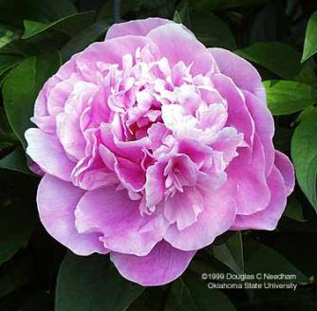
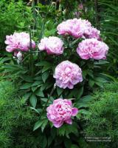
Peony
Botanical name: Paeonia cv.
Origin: Asia, southern Europe and western North America
Color: pink, purple and white

Slide 16
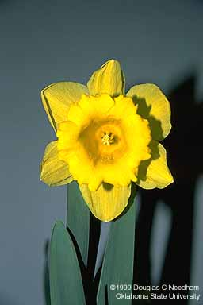
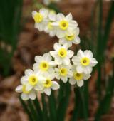
Daffodil
Botanical name: Narcissus pseudonarcissus cv.
Origin: Europe, North Africa and Asia
Color: yellow and white

Slide 17
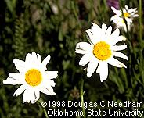
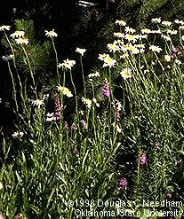
Shasta Daisy
Botanical name: Leucanthemum x superbum cv.
Origin: California
Color: white

Slide 18
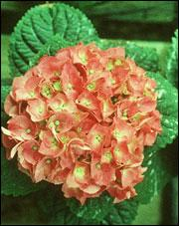
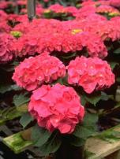
French (Florist’s) Hydrangea
Botanical name: Hydrangea macrophylla cv.
Origin: Japan
Color: blue, purple, pink, salmon and white

Slide 19
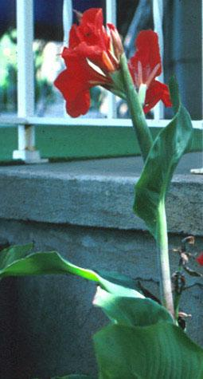
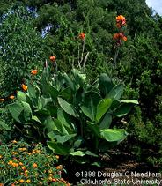
Common Garden Canna
Botanical name: Canna x generalis
Origin: Argentina and southern United States
Color: orange, pink, yellow and red

Slide 20
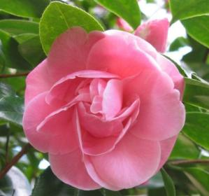
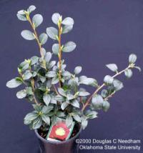
Common Camellia
Click to return to Mass
Botanical name: Camellia japonica
Origin: Japan, Korea and China
Color: red and pink

Slide 21
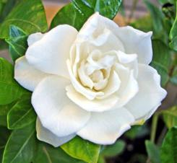
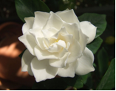
Gardenia
Botanical name: Gardenia jasminoides ‘Fortuniana’
Origin: tropical and subtropical regions of Africa, southeast Asia, Australia and Oceania
Color: white and cream

Slide 22
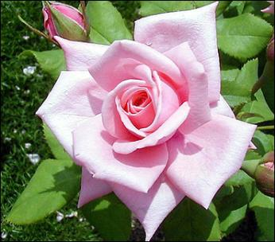
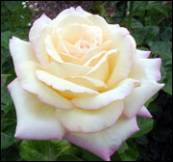
Hybrid Tea Rose
Botanical name: Rosa hybrid cv., Class Hybrid Tea cv.
Origin: France
Color: red, pink, yellow, orange and white

Slide 23
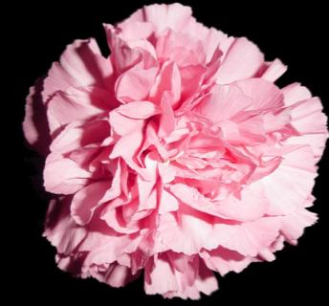
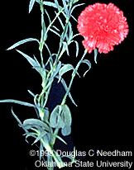
Carnation
Botanical name: Dianthus caryophyllus cv.
Origin: Mediterranean region
Color: white, pink, salmon, red, yellow, violet and shades in between

Slide 24
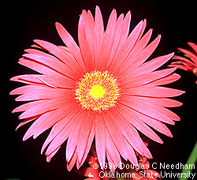
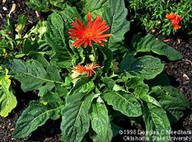
Transvaal Daisy
Botanical name: Gerbera jamesonii
Origin: South America, Africa and Asia
Color: white, cream, yellow, salmon, pink, orange and red

Slide 25
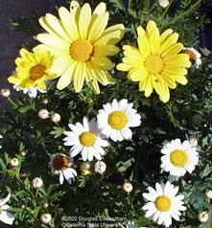
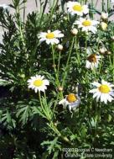
Marguerite Daisy
Botanical name: Argyranthemum frutescens
Origin: Canary Islands
Color: white and yellow, white blossoms occasionally, commercially tinted pink or blue

Slide 26
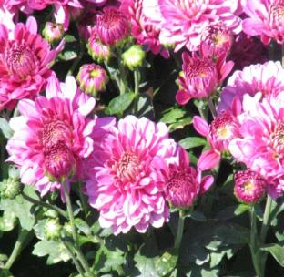
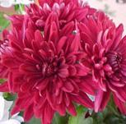
Florist’s Chrysanthemum
Botanical name: Chrysanthemum x moriflium cv.
Origin: Asia and northeastern Europe
Color: white, gold, yellow, shades of pink, lavender, bronze and red

Slide 27
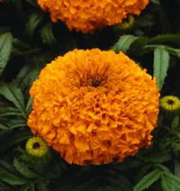
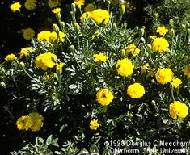
Marigold
Botanical name: Tagetes species cv.
Origin: North and South America
Color: yellow and orange

Slide 28
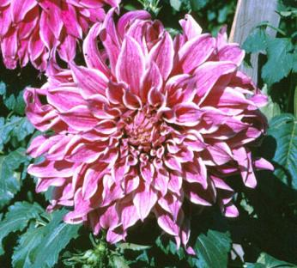
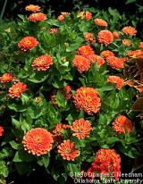
Zinnia
Botanical name: Zinnia elegans
Origin: southwest United States, South America and Mexico
Color: all colors except blue

Slide 29
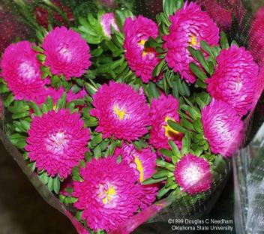
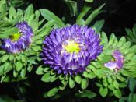
China Aster
Botanical name: Callistephus chinensis
Origin: China
Color: white, red, pink, lavender and violet

Slide 30
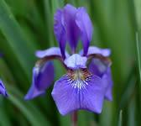
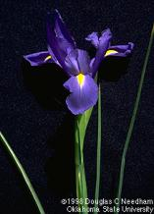
Dutch Iris
Botanical name: Iris x xiphium cv.
Origin: Spain and Portugal
Color: royal, yellow, white and purple

Slide 31
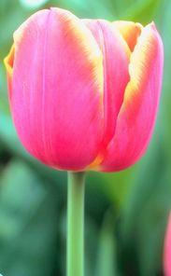
Tulip
Botanical name: Tulipa cv.
Origin: southern Europe, north Africa, Anatolia and Iran to northwest China
Color: red, yellow, pink, violet and white

Slide 32
Freesia
Botanical name: Freesia x hybrida
Origin: Africa
Color: white, orange, yellow, pink, red and violet

Slide 33
Shrimp Plant
Botanical name: Justicia brandegeana
Origin: Mexico, Guatemala, and Honduras
Color: yellow, orange and red

Slide 34
Flag (Bearded) Iris
Return to
Main Menu
Botanical name: Iris x germanica florentina cv.
Origin: Europe, the Middle East and northern Africa, Asia and across North America
Color: violet, blue, yellow and white

