Slide 1
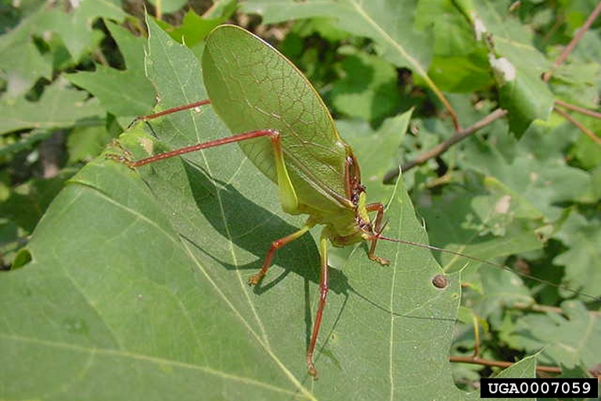
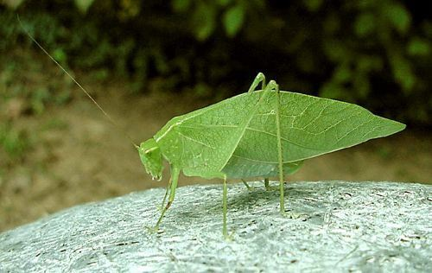
075 Katydid
Orthoptera
Hemimetabolous
Chewing
Variable

Slide 2
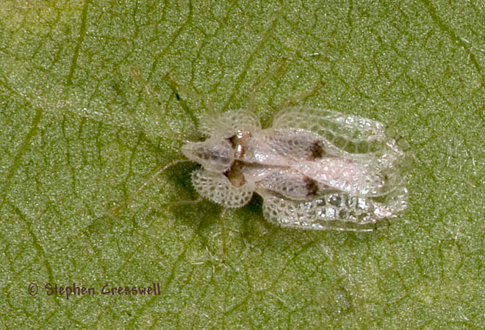
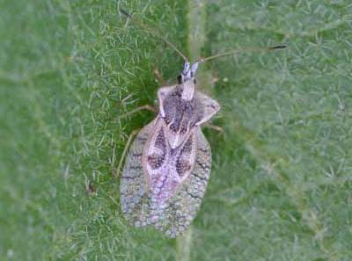
076 Lace bug
Hemiptera
Hemimetabolous
Piercing-sucking
Pest

Slide 3
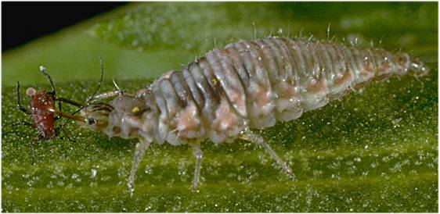
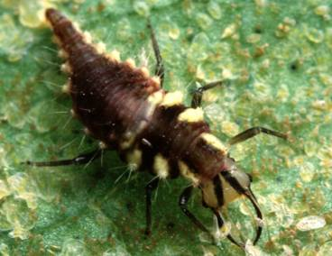
077 Lacewing larva
Neuroptera
Holometabolous
Chewing
Beneficial

Slide 4
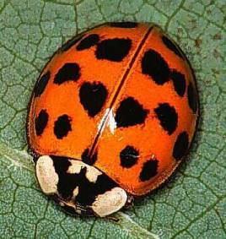
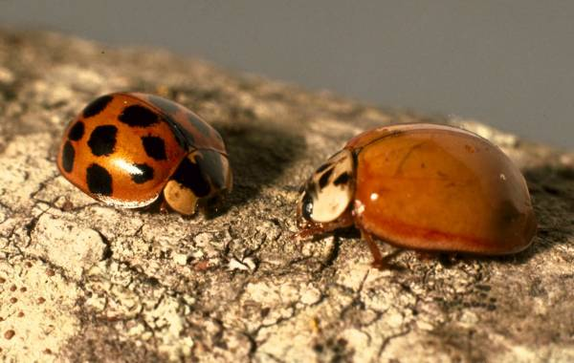
078 Ladybird beetle
Coleoptera
Holometabolous
Chewing
Beneficial

Slide 5
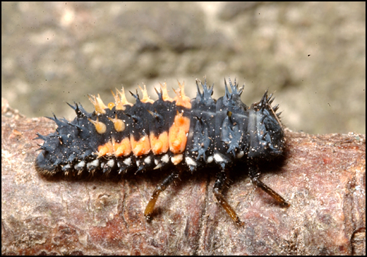
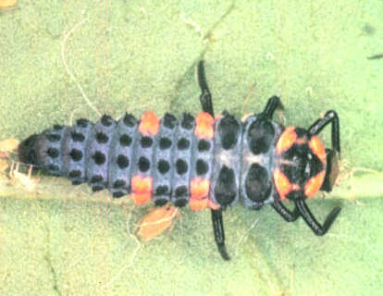
079 Ladybird beetle larva
Coleoptera
Holometabolous
Chewing
Beneficial

Slide 6
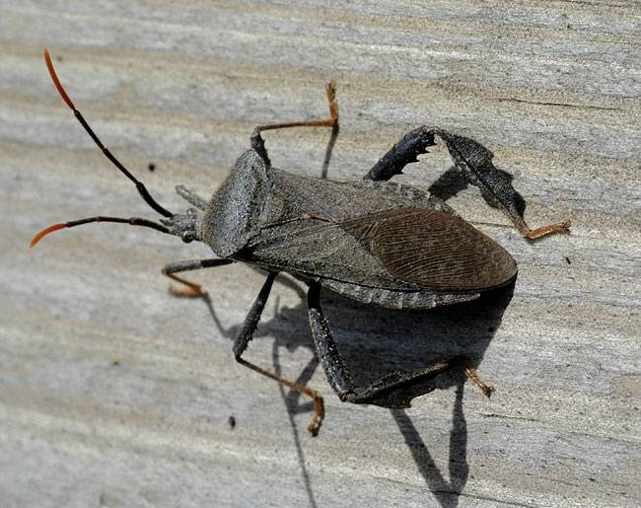
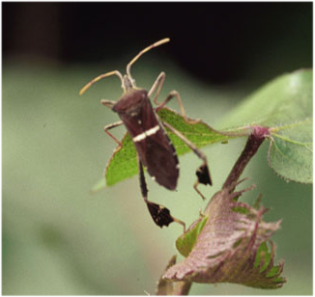
080 Leaf-footed bug
Hemiptera
Hemimetabolous
Piercing-sucking
Pest

Slide 7
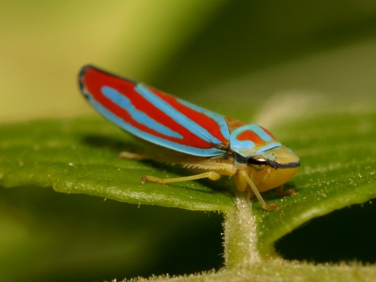
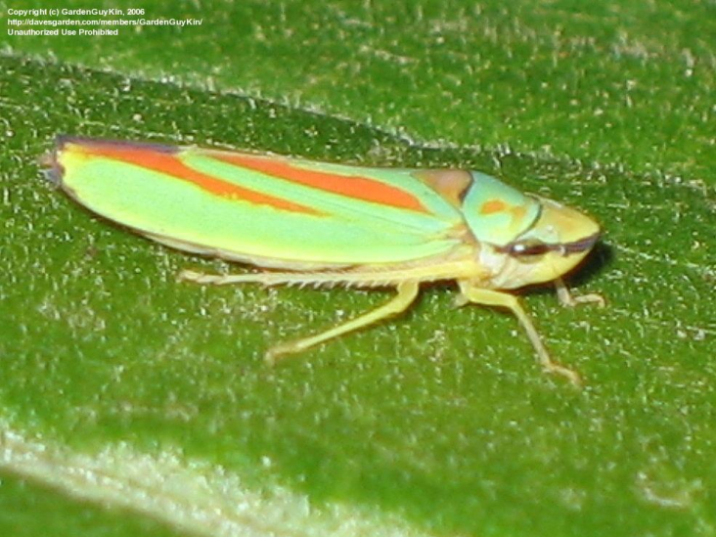
081 Leafhopper
Hemiptera
Hemimetabolous
Piercing-sucking
Pest

Slide 8
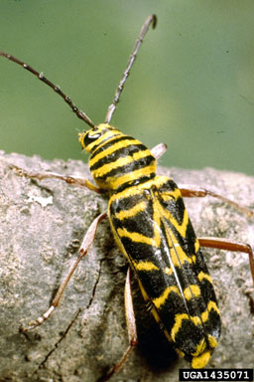
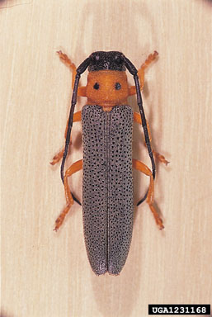
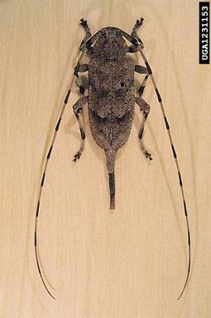
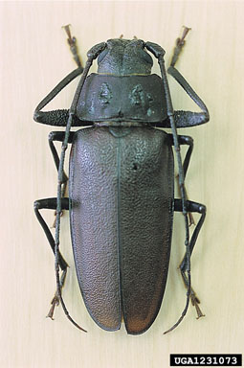
082 Longhorned beetle
Coleoptera
Holometabolous
Chewing
Pest

Slide 9
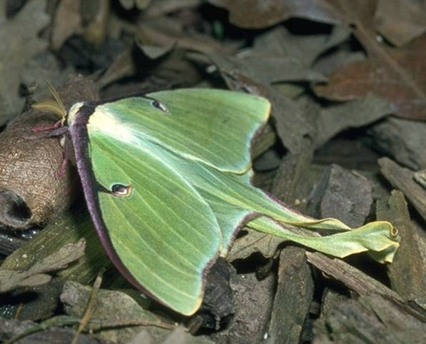
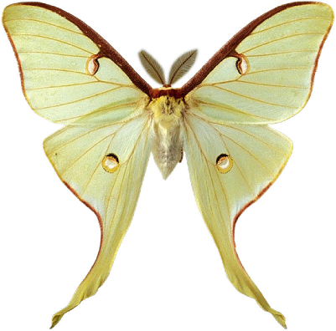
083 Luna moth
Lepidoptera
Holometabolous
Siphoning
Beneficial

Slide 10
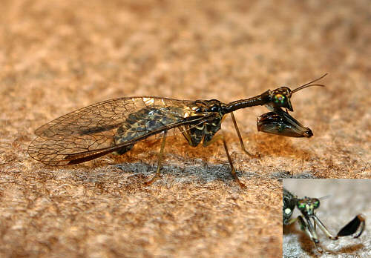
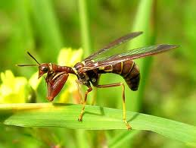
084 Mantidfly
Neuroptera
Holometabolous
Chewing
Beneficial

Slide 11
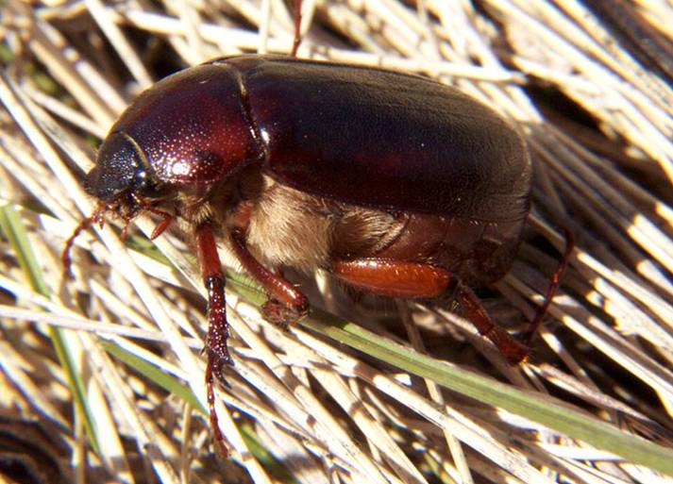
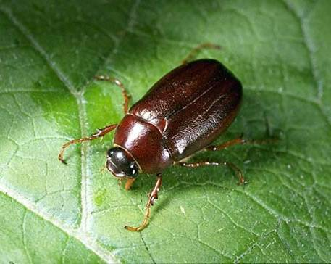
085 May beetle
Coleoptera
Holometabolous
Chewing
Pest

Slide 12
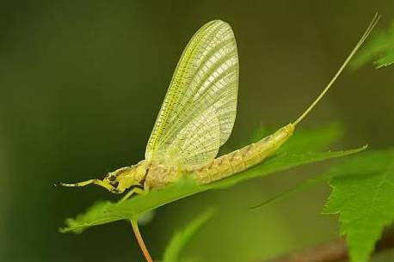
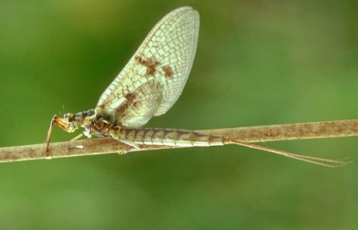
086 Mayfly
Ephemeroptera
Hemimetabolous
Vestigial
beneficial
IN glass vial

Slide 13
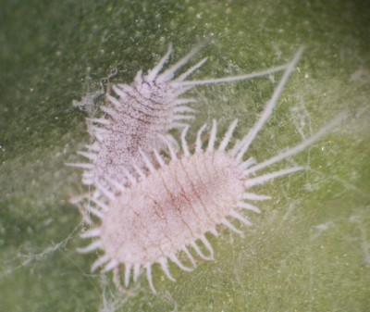
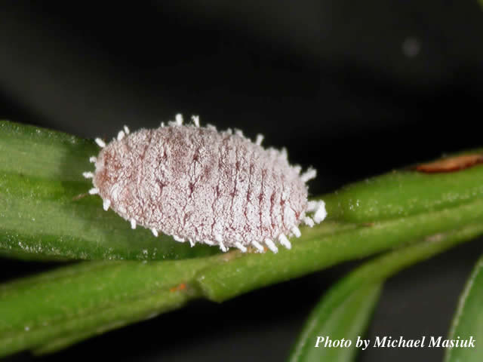
087 Mealybug
Hemiptera
Hemimetabolous
Piercing-sucking
Pest

Slide 14
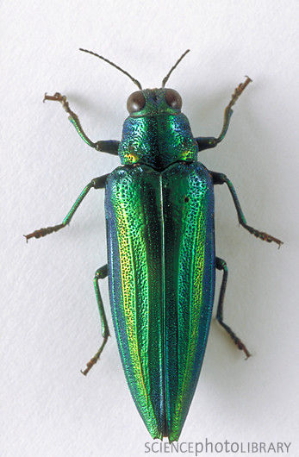
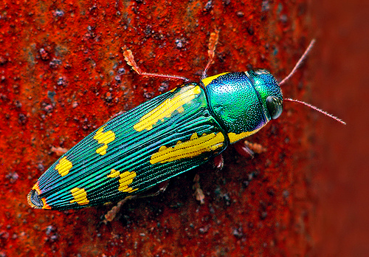
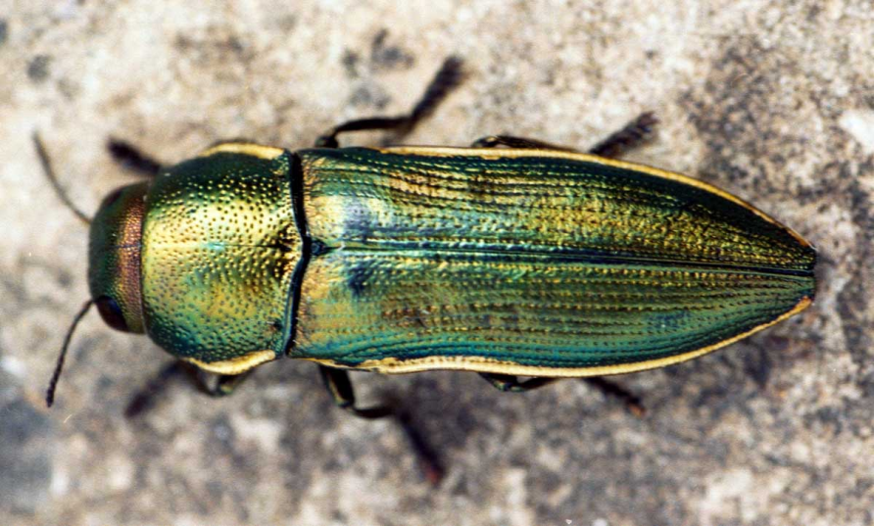
088 Metallic wood boring beetle
Coleoptera
Holometabolous
Chewing
Pest

Slide 15
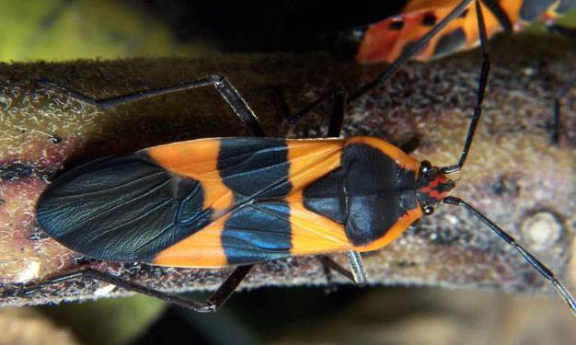
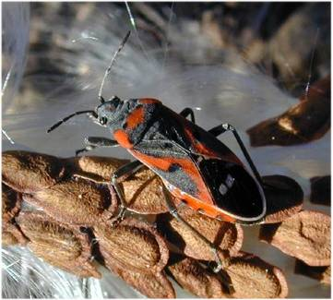
089 Milkweed bug
Hemiptera
Hemimetabolous
Piercing-sucking
Pest

Slide 16
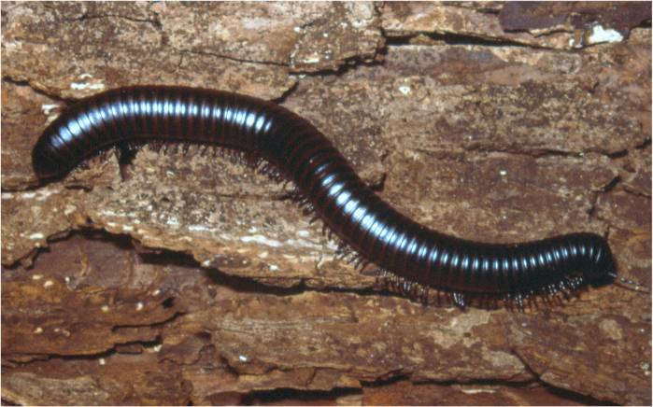
090 Millipede
Non-insect
Chewing
Beneficial

Slide 17
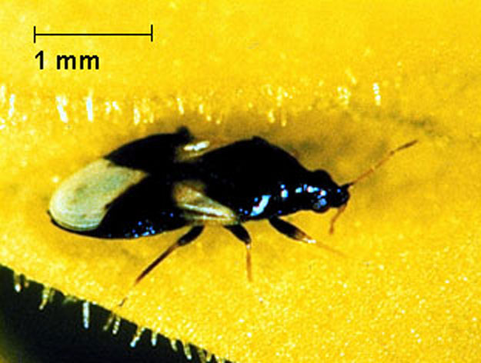
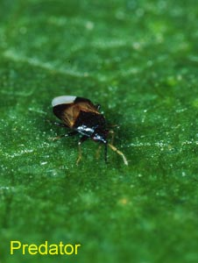
091 Minute pirate bug
Hemiptera
Hemimetabolous
Piercing-sucking
Beneficial

Slide 18
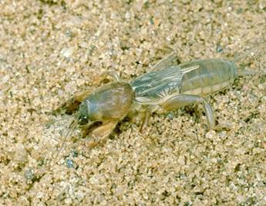
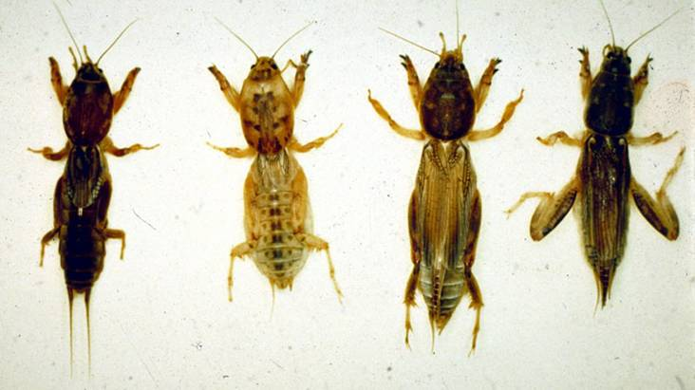
092 Mole cricket
Orthoptera
Hemimetabolous
Chewing
Pest

Slide 19
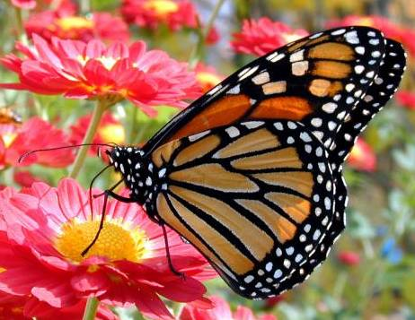
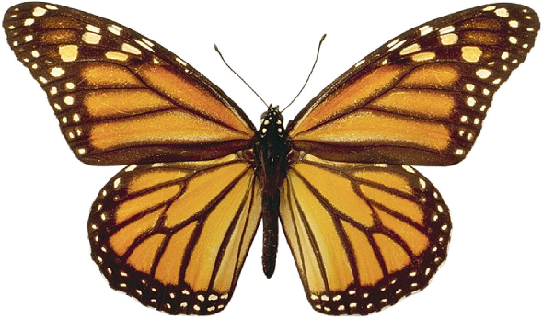
093 Monarch butterfly
Lepidoptera
Holometabolous
Siphoning
Beneficial

Slide 20
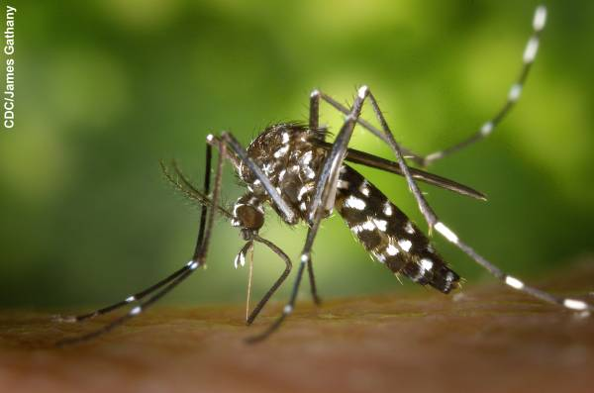
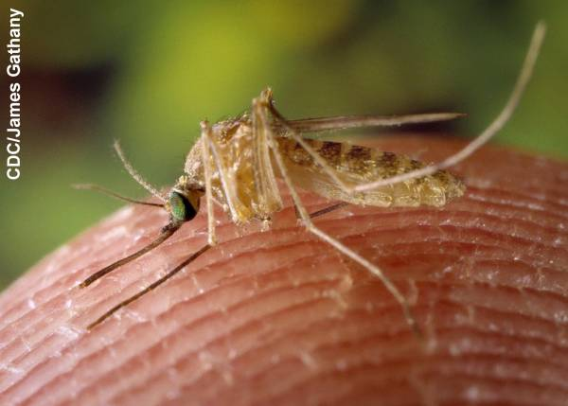
094 Mosquito
Diptera
Holometabolous
Piercing-sucking
Pest

