Slide 1
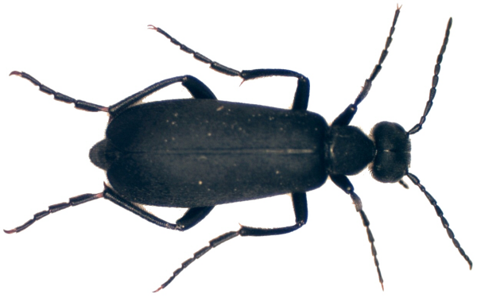
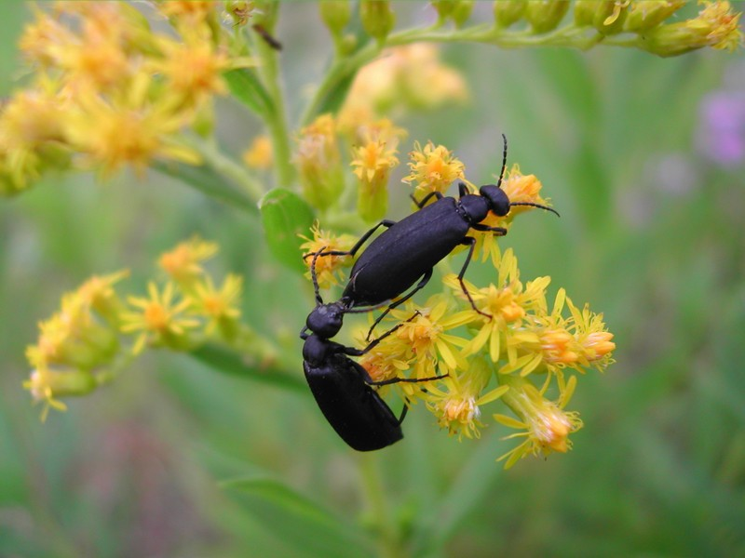
015 Blister beetle
Coleoptera
holometabolous
Chewing
Pest

Slide 2
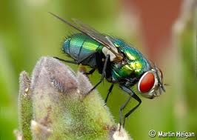
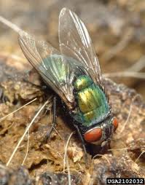
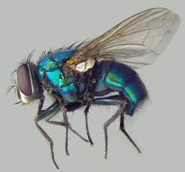
016 Blow fly
Diptera
Holometabolous
Sponging
Pest

Slide 3
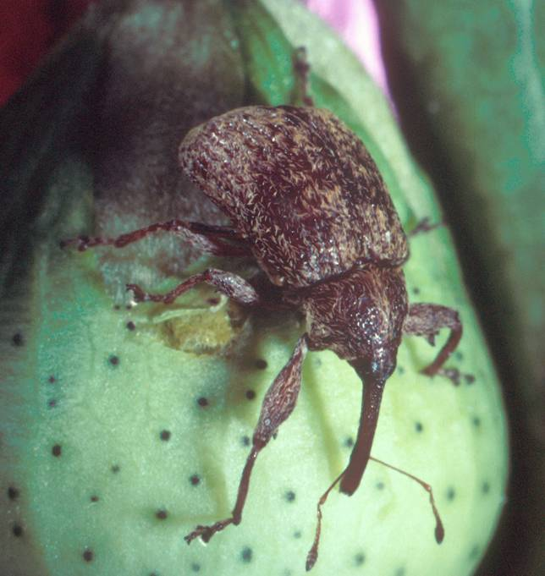
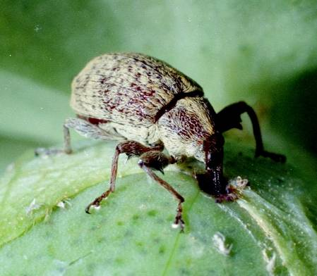
017 Boll weevil
Coleoptera
Holometabolous
Chewing
Pest

Slide 4
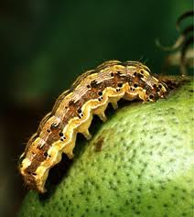
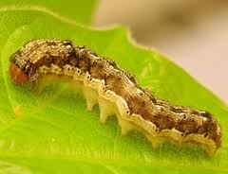
018 Bollworm
Lepidoptera
Holo-metabolous
Chewing
Pest

Slide 5
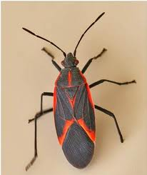
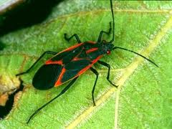
019 Boxelder bug
Hemiptera
Hemimetabolous
Piercing-sucking
Pest

Slide 6
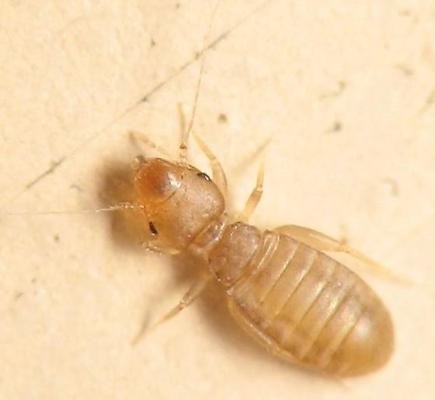
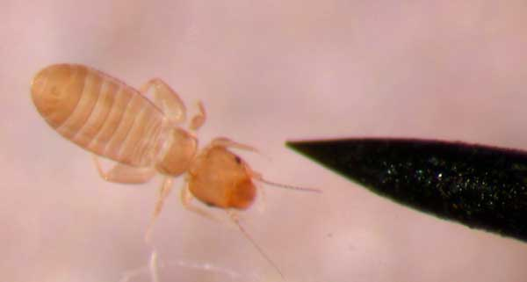
020 Book louse
Psocoptera
Ametabolus
Chewing
Pest

Slide 7
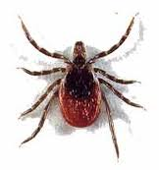
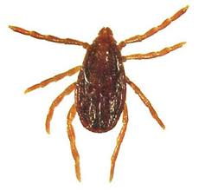
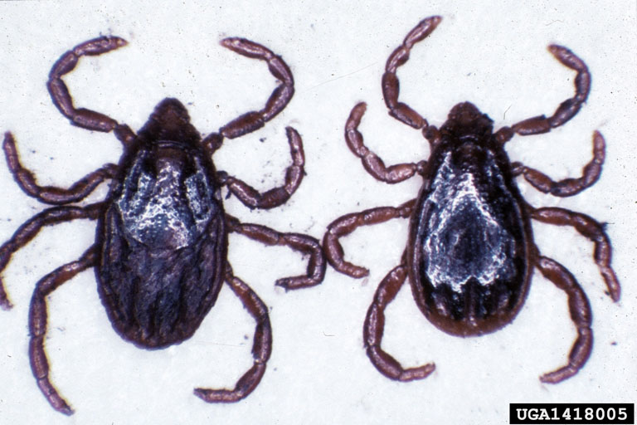
021 Brown dog tick
Non-insect
Piercing-sucking
Pest

Slide 8
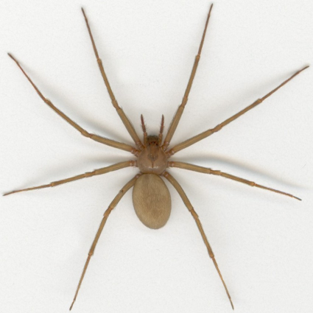
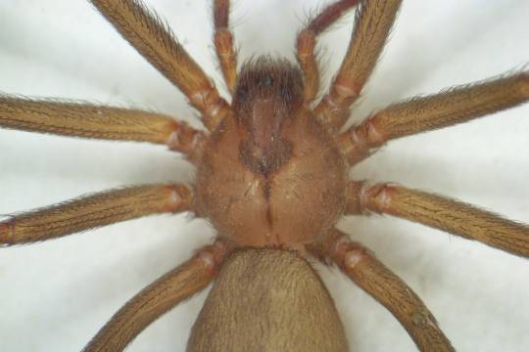
022 Brown recluse spider
Non-insect
Pest

Slide 9
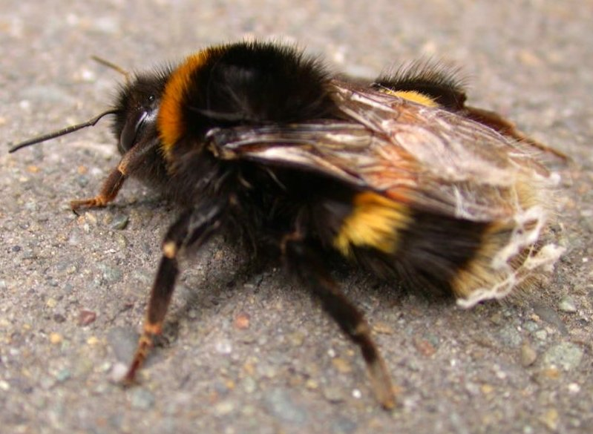
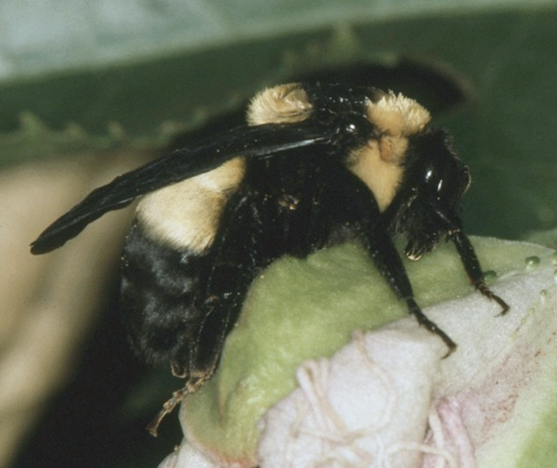
023 Bumble bee
Hymenoptera
Holometabolous
Chewing-lapping
Variable (Pest and Beneficial)

Slide 10
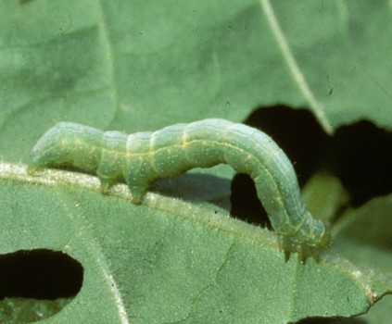
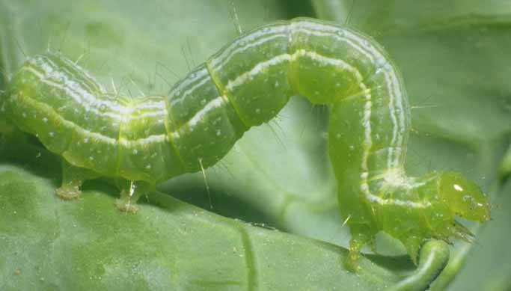
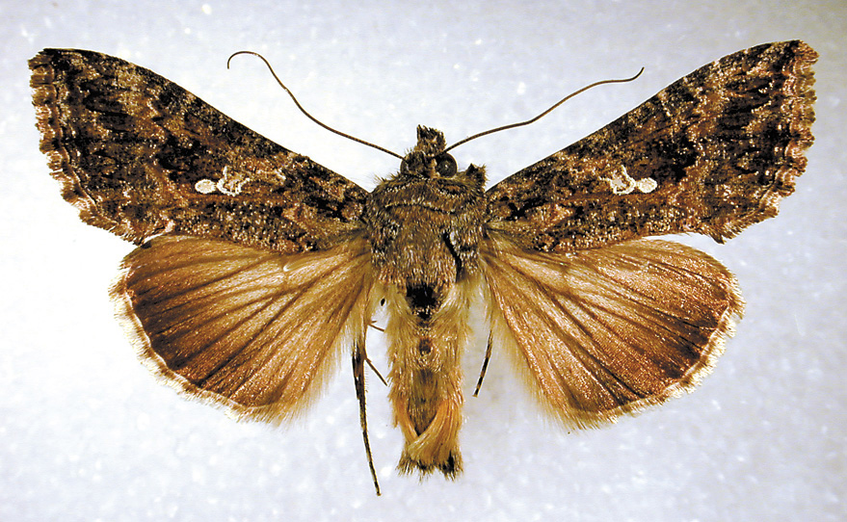
024 Cabbage looper
Lepidoptera
Holometabolous
Chewing
Pest

Slide 11
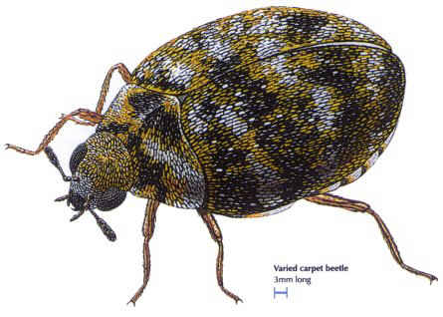
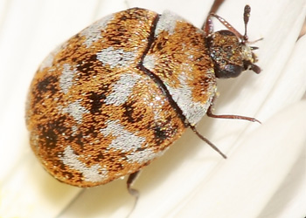
025 Carpet beetle
Coleoptera
Holometabolous
Chewing
Pest

Slide 12
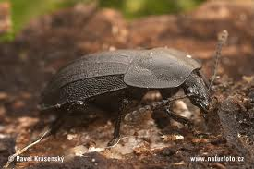
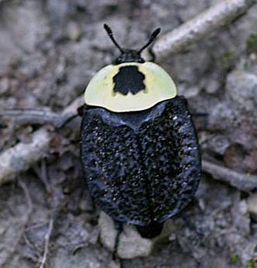
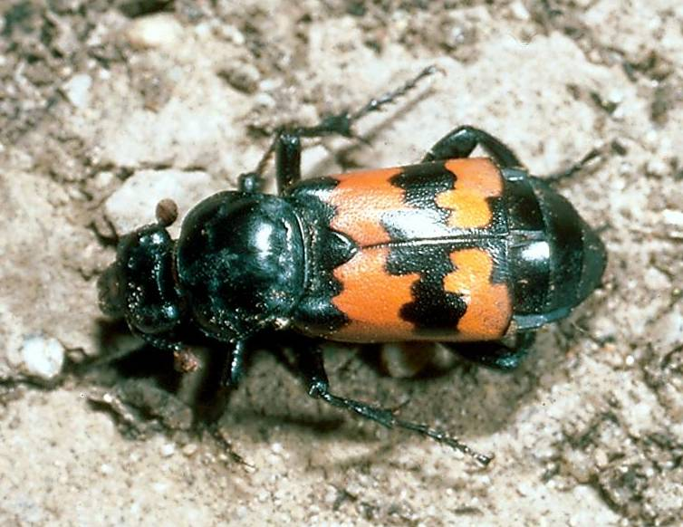
026 Carrion beetle
Coleoptera
Holometabolous
Chewing
Beneficial

Slide 13
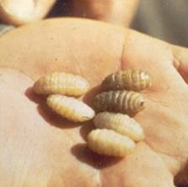
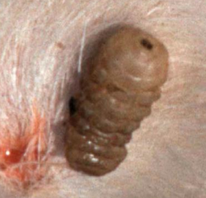
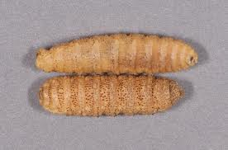
027 Cattle grub
Diptera
Holometabolous
Chewing
Pest

Slide 14
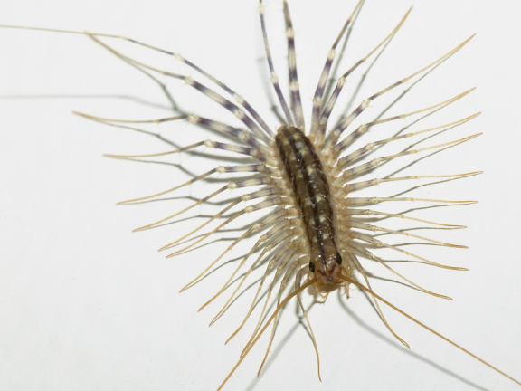
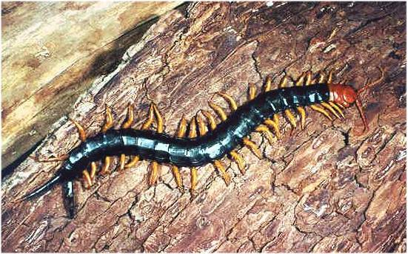
028 Centipede
Non-insect
Variable

Slide 15
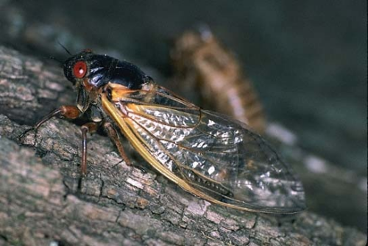
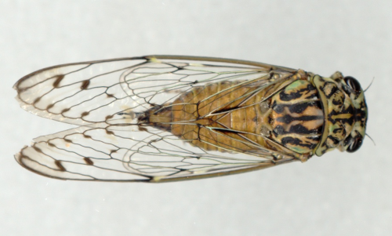
029 Cicada
Hemiptera
Hemimetabolous
Piercing-sucking
Variable

Slide 16
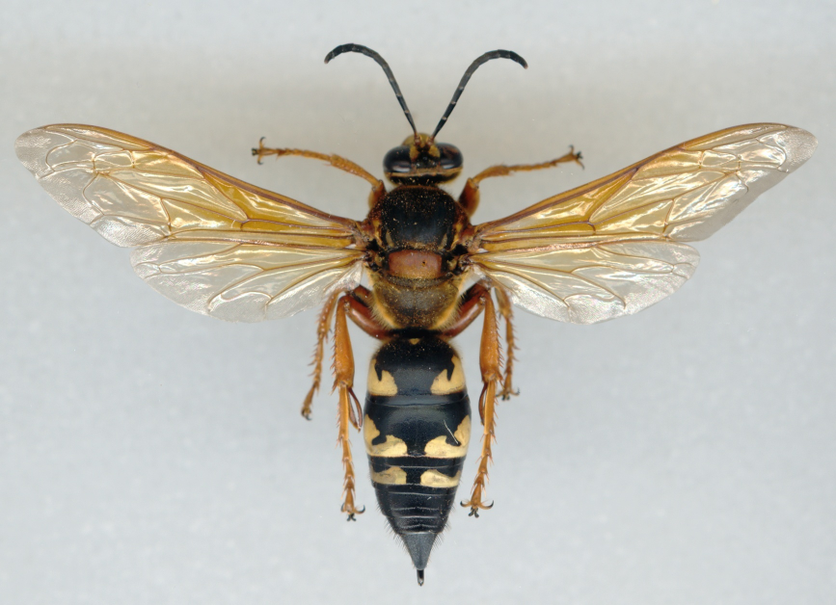
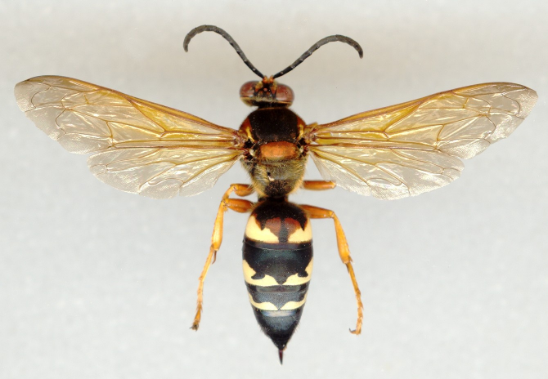
030 Cicada Killer
Hymenoptera
Colometabolous
Chewing
Beneficial

Slide 17
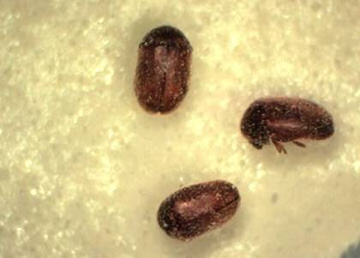
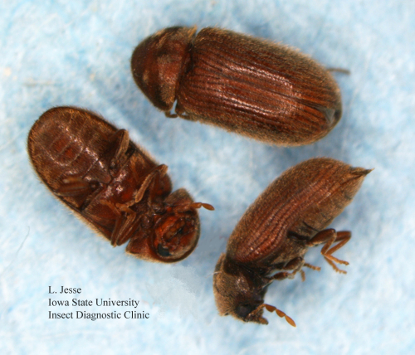
031 Cigarette beetle
Coleoptera
Holometabolous
Chewing
Pest

Slide 18
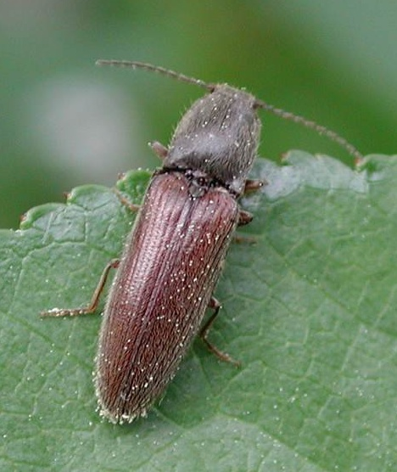
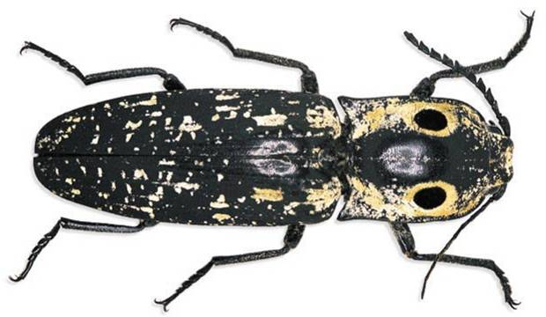
032 Click beetle
Coleoptera
Holometabolous
Chewing
Variable (Beneficial and Pest)

Slide 19
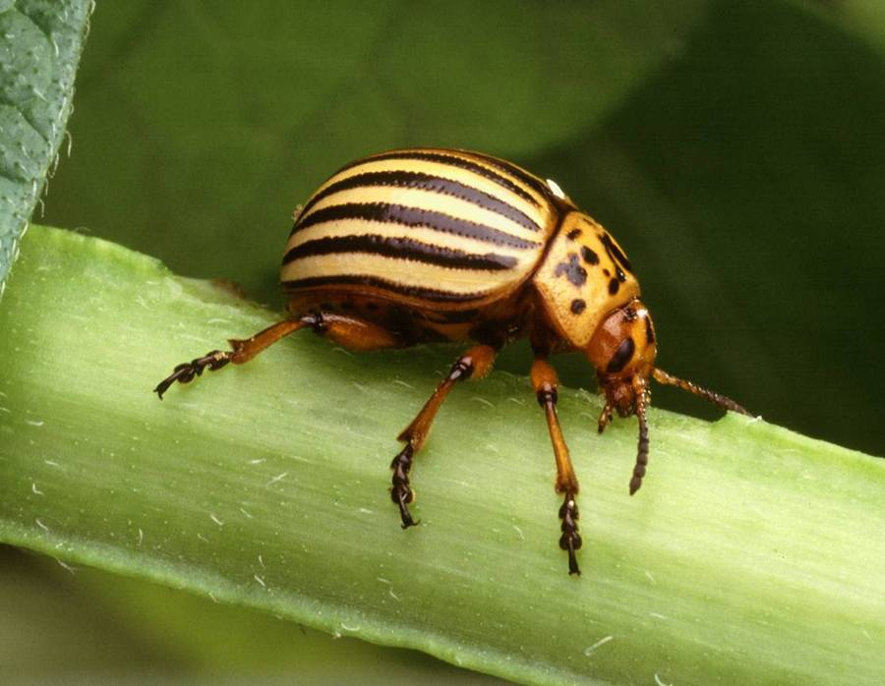
033 Colorado potato beetle
Coleoptera
Holometabolous
Chewing
Pest

Slide 20
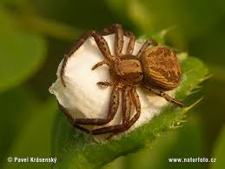
034 Crab spider
Non-insect
Beneficial

