Slide 1
Entomology CDE Slide Show

Slide 2
Metamorphosis
1. Complete Metamorphosis (holometabolous). Larvae and adults of these insects are very different and a distinct pupae is formed. Some insects with complete metamorphosis are: beetles, flies, bees, lacewings, butterflies, ants, and caddis flies.

Slide 3
Metamorhposis
2. Incomplete (or simple) Metamorphosis (hemimetabolous). In these insects, the nymph more or less resembles the adult and there is no pupal stage. The example shown below is a plant bug. Some other insects with incomplete metamorphosis are: crickets, true bugs, termites, grasshoppers, and cockroaches

Slide 4
Metamorphosis
3. Ametabolous insects show no metamorphosis. Here the adult looks like the immature except for the presence of genetalia and gonads. The silverfish is an example.
The exoskeleton limits the potential size of insects, but provides valuable protection to all parts of the insect including its eyes, antennae and the internal breathing tubes (tracheae). To grow and become an adult, young insects shed or molt their exoskeleton. Molting happens several times before an insect becomes an adult. A new, flexible skeleton forms beneath the old, hard exoskeleton. While taking in extra air, the insect expands itself and splits the old skin. After crawling out of the old skin, the new, soft exoskeleton starts to harden in minutes but may take several hours or days to harden completely. For some insects like a butterfly, the caterpillar is very different from the adult butterfly. In other insects like grasshoppers the young insects resemble the adults. The younger stages, called nymphs may have different color patterns and undeveloped wings and sexual organs compared with the adult. Compare the pictures above to see the difference between these two kinds of metamorphosis.

Slide 5
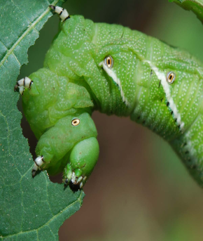
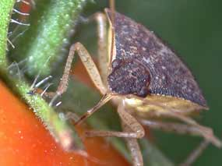
Types of Mouthparts
Chewing - feed by biting, ripping or tearing plant tissue.
Piercing/Sucking - insects have a beak, referred to as a proboscis, that is modified to suck up liquids in a manner similar to humans sucking through a straw

Slide 6
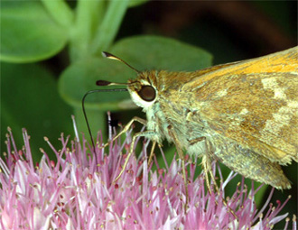
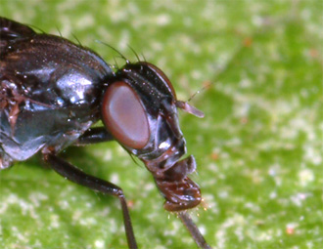
Types of Mouthparts
Siphoning - adapted to draw nectar from long-throated flowers
Sponging - appear as a conical process with spongelike lobes at the end. This type of mouth is modified to lap up liquids

Slide 7
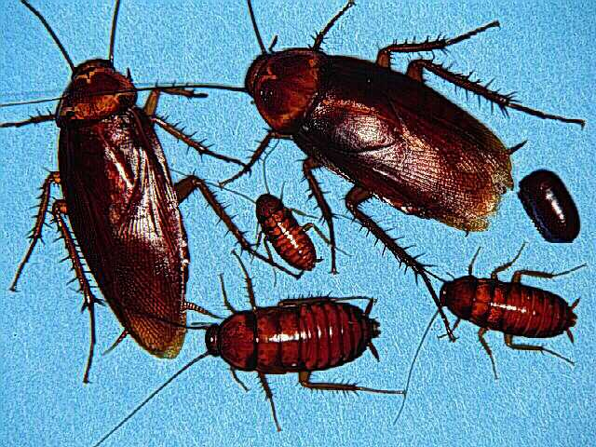
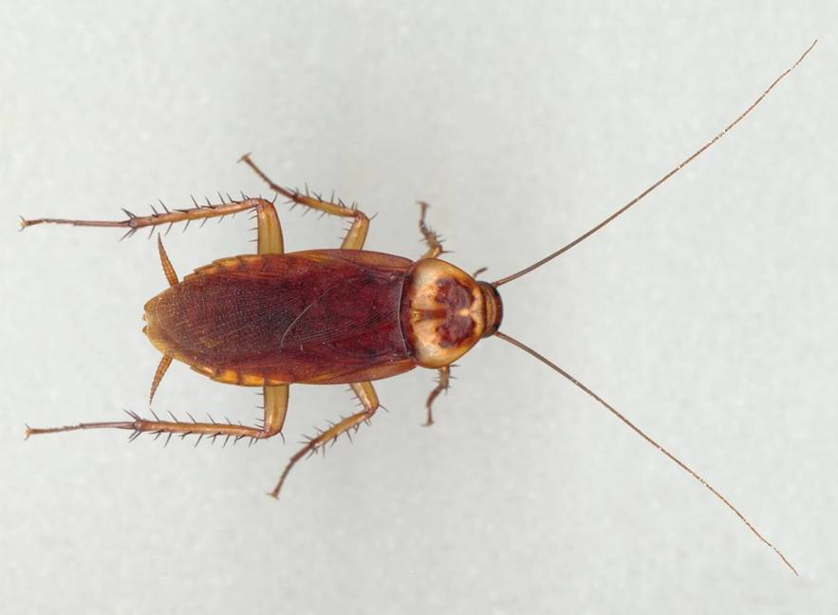
001 American cockroach
Order Blattodea
Hemi-metabolous
Chewing Mouthpart
Pest

Slide 8
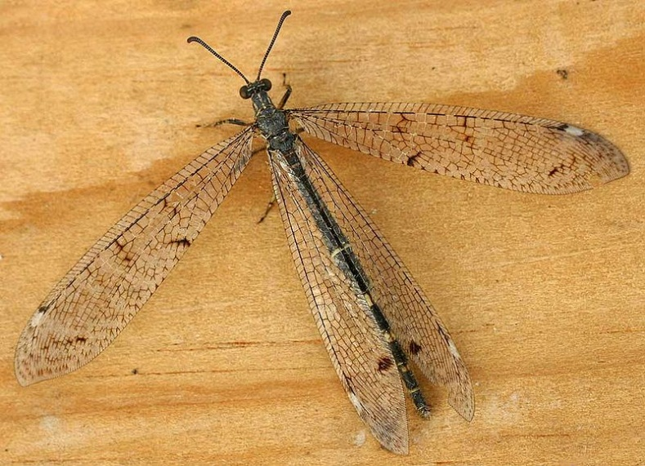
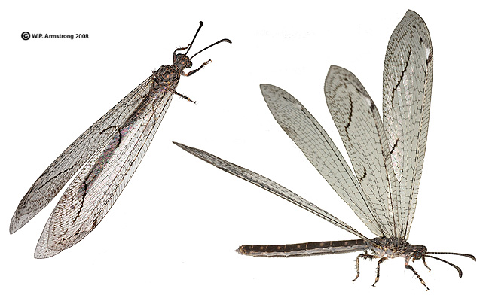
002 Antlion
Neuroptera
Holometabolous
Chewing outhpart
Beneficial

Slide 9
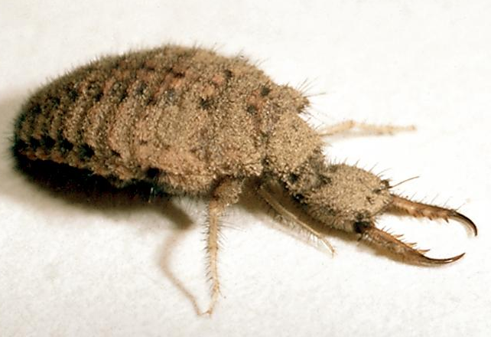
003 Antlion Larvae
Neuroptera
Holometabolous
Chewing outhpart
Beneficial

Slide 10
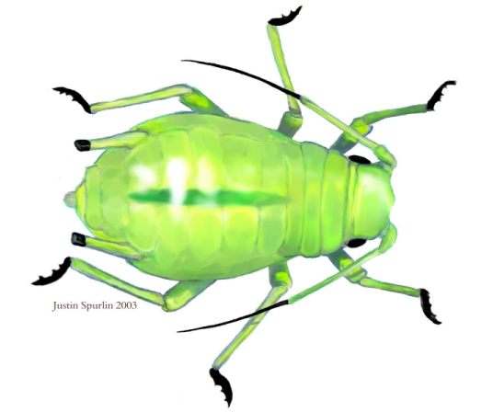
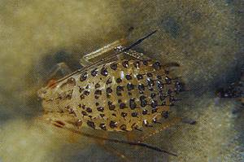
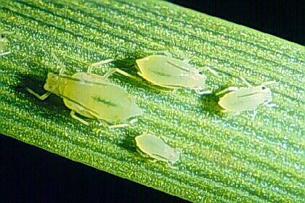
004 Aphid
Hemiptera
Hemimetabolous
Piercing-sucking
Pest

Slide 11
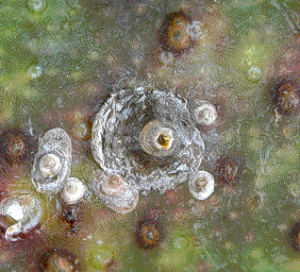
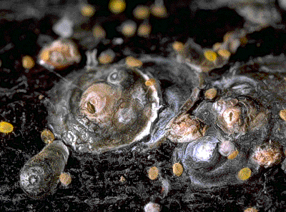
005 Armored scale
Hemiptera
Hemimetabolous
Piercing-sucking
Pest

Slide 12
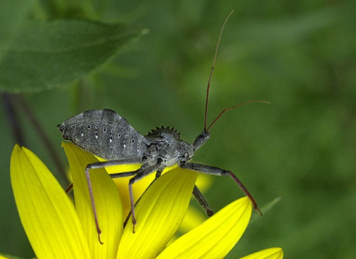
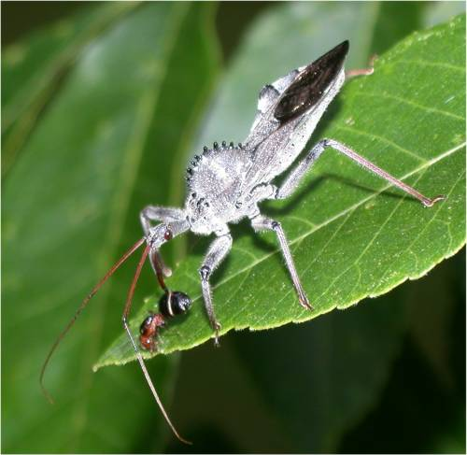
006 Assassin Bug
Hemiptera
Hemimetabolous
Piercing-sucking
Beneficial

Slide 13
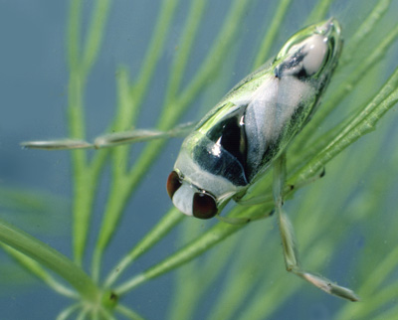
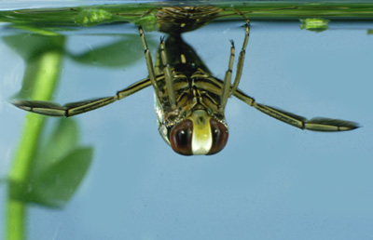
007 Backswimmer
Hemiptera
Hemimetabolous
Piercing-sucking
Beneficial

Slide 14
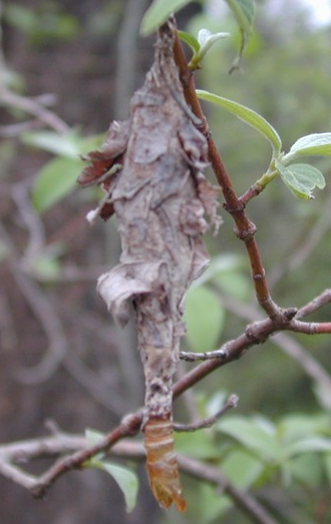
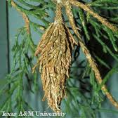
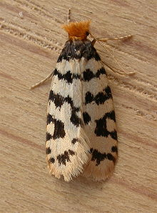
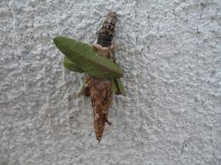
008 Bagworm
Lepidoptera
Holometabolous
Chewing
Pest

Slide 15
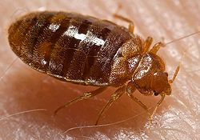
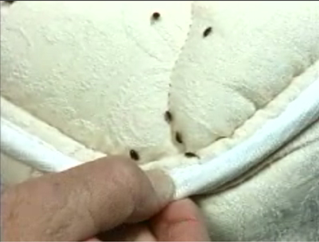
009 Bed bug
Hemiptera
Hemimetabolous
Piercing-sucking
Pest

Slide 16
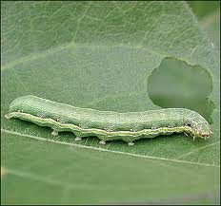
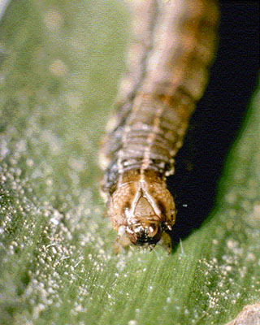
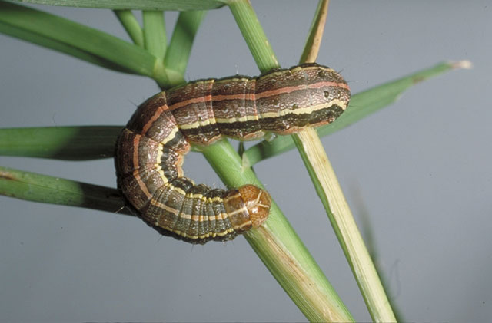
010 Beet armyworm larva
Lepidoptera
Holometabolous
Chewing
Pest

Slide 17
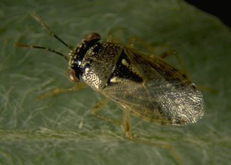
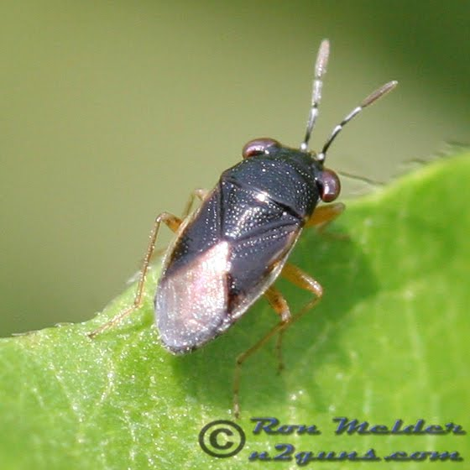
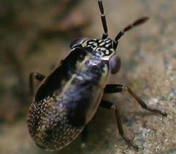
011 Big-eyed bug
Hemiptera
Hemimetabolous
Piercing-sucking
Beneficial

Slide 18
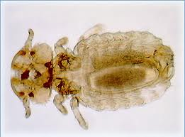
012 Biting louse
Phthiraptera
Hemimetabolous
Chewing
Pest

Slide 19
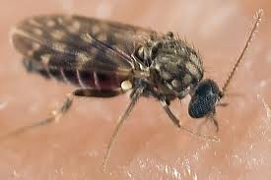
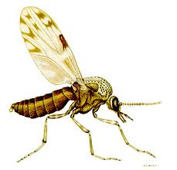
013 Biting midge
Diptera
Holometablous
Piercing-sucking
Pest

Slide 20
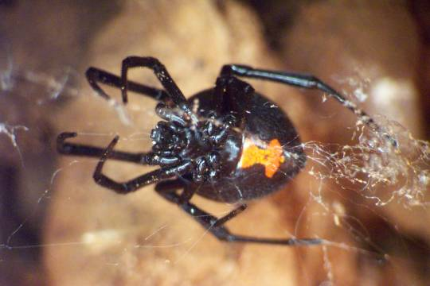
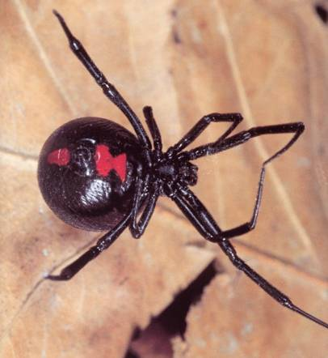
014 Black widow spider
Non-insect
Pest

