Slide 1
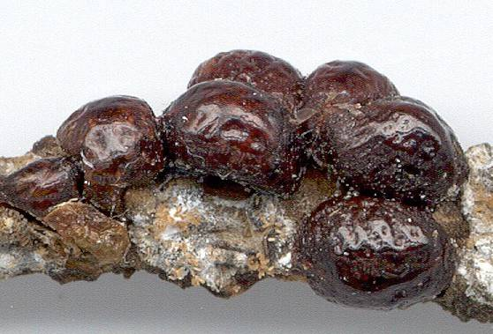
115 Soft scale
Hemiptera
Hemimetabolous
Piercing-sucking
Pest

Slide 2
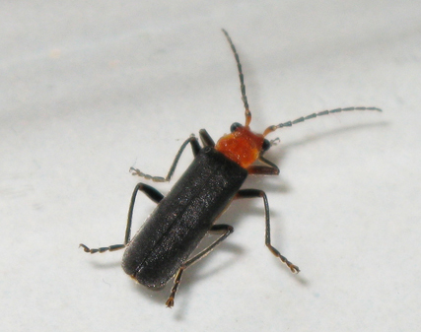
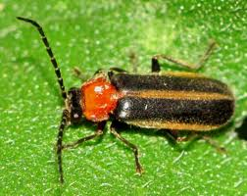
116 Soldier beetle
Coleoptera
Holometabolous
Chewing
Beneficial
Notice Orange Thorax

Slide 3
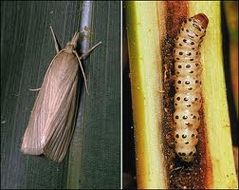
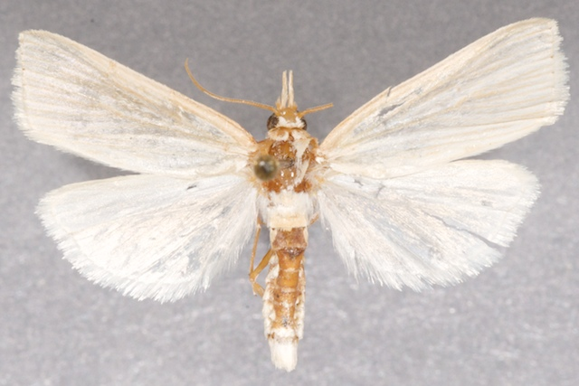
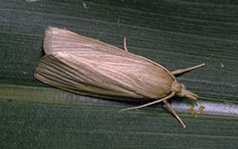
117 Southwestern corn borer
Lepidoptera
Holometabolous
Chewing
Pest

Slide 4
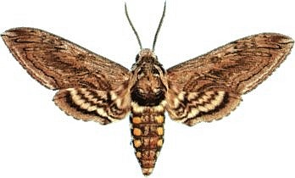
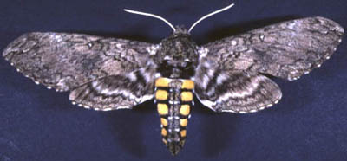
118 Sphinx moth
Lepidoptera
Holometabolous
Siphoning
Variable (Beneficial and Pest)

Slide 5
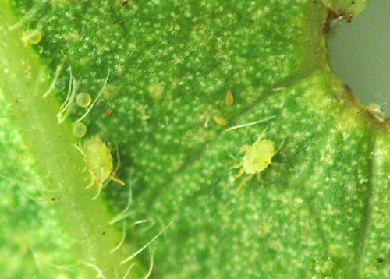
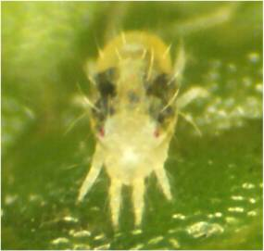
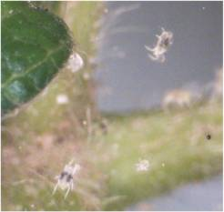
119 Spider mite
Non-insect
Piercing-sucking
Pest
8 legs

Slide 6
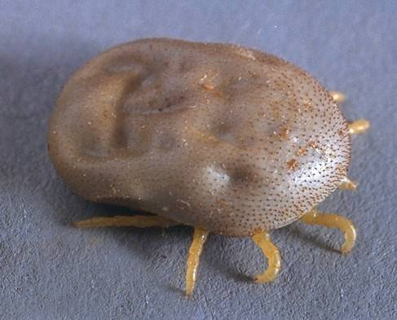
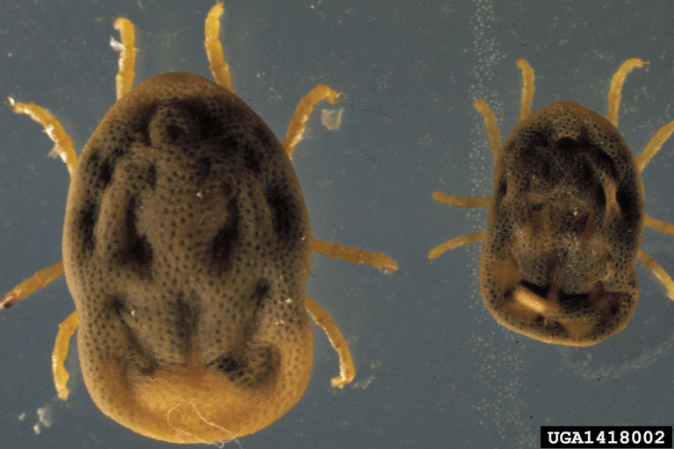
120 Spinose ear tick
Non insect
Piercing-sucking
Pest

Slide 7
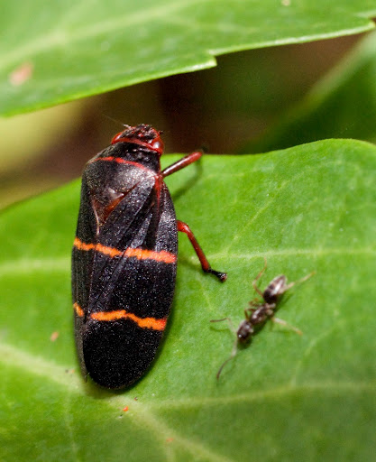
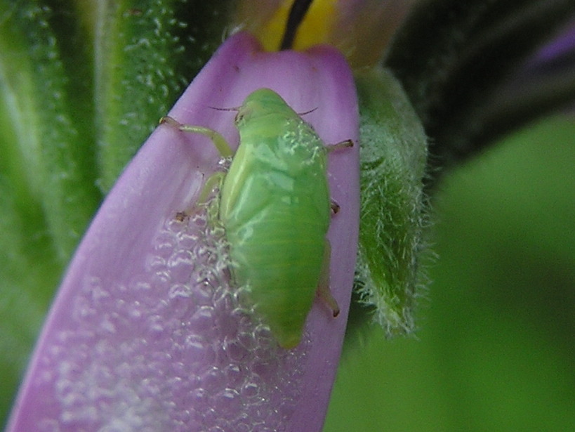
121 Spittlebug
Hemiptera
Hemimetabolous
Piercing-sucking
Pest
Adult
Larvae

Slide 8
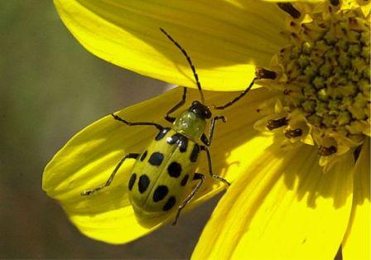
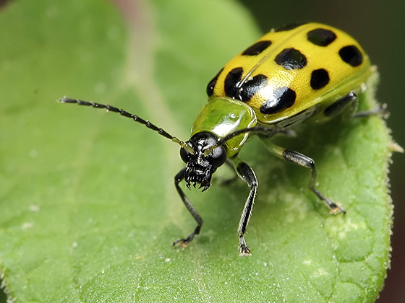
122 Spotted cucumber beetle
Coleoptera
Holometabolous
Chewing
Pest

Slide 9
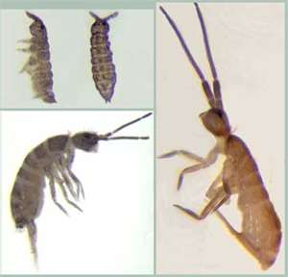
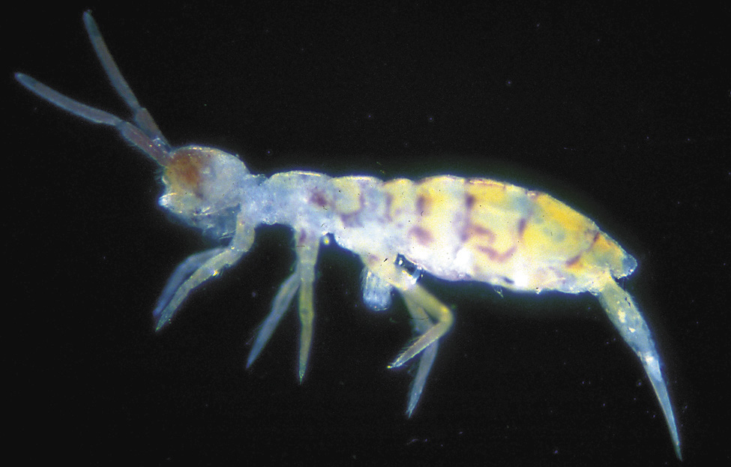
123 Springtail
Collembola
Ametabolous
Chewing
Variable (Pest and Beneficial)
Micrscopic – Notice spike out of abdomen, that is the spring

Slide 10
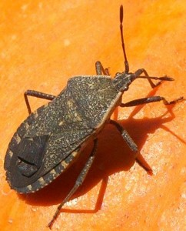
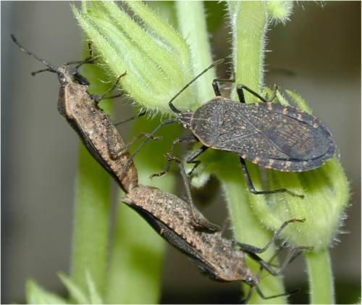
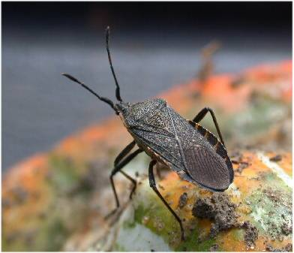
124 Squash bug
Hemiptera
Hemimetabolous
Piercing-sucking
Pest

Slide 11
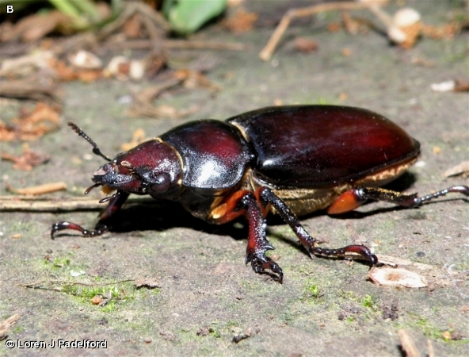
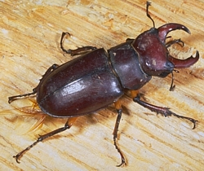
125 Stag beetle
Coleoptera
Holometabolous
Chewing
Variable (Pest and Beneficial)

Slide 12
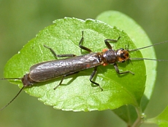
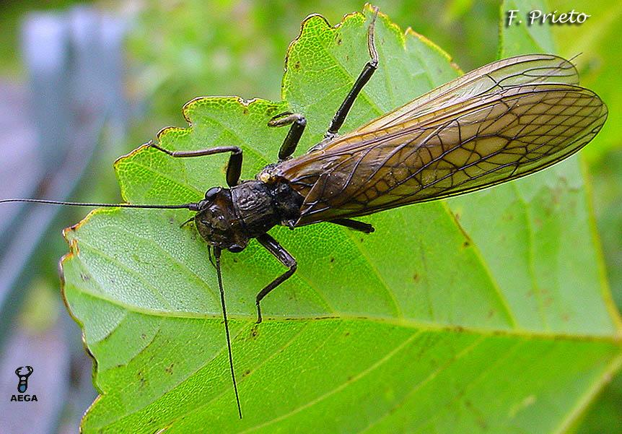
126 Stonefly
Plecoptera
Hemimetabolous
Chewing
Beneficial

Slide 13
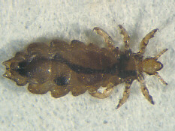
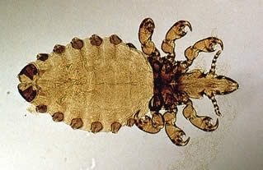
127 Sucking louse
Phthiraptera
Hemimetabolous
Piercing-sucking
Pest

Slide 14
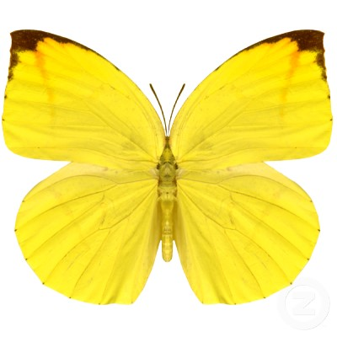
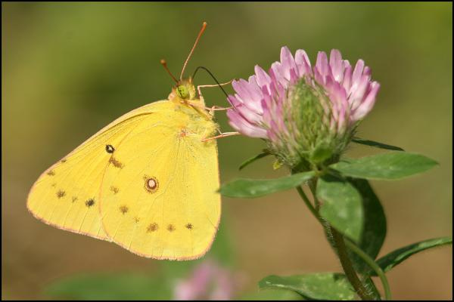
128 Sulphur butterfly
Lepidoptera
Holometabolous
Siphoning
Pest

Slide 15
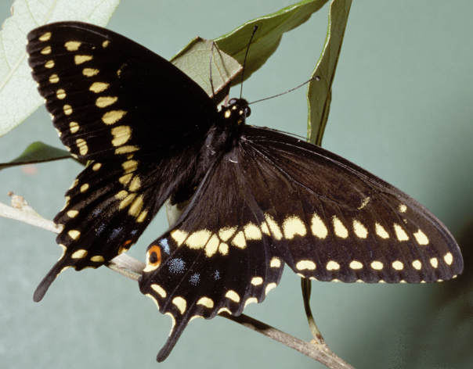
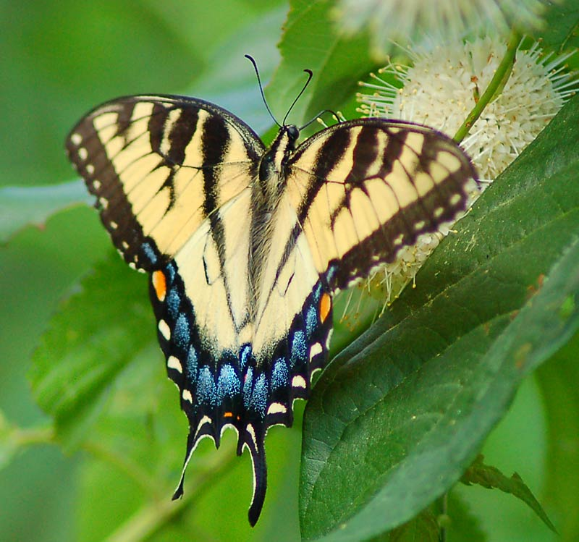
129 Swallowtail butterfly
Lepidoptera
Holometabolous
Siphoning
Beneficial

Slide 16
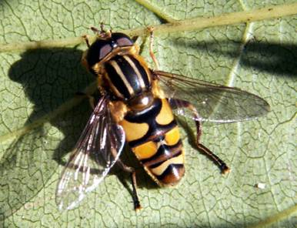
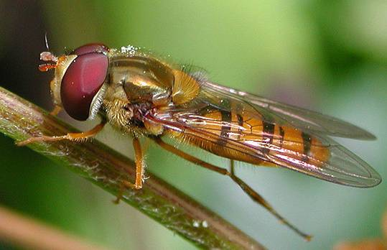
130 Syrphid fly
Looks like a bee with only 2 wings
Diptera
Holometabolous
Sponging
Variable (Beneficial and Pest)

Slide 17
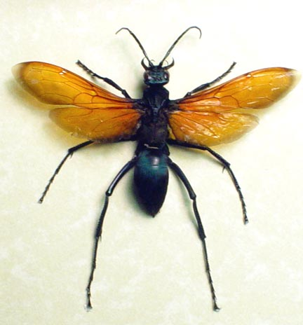
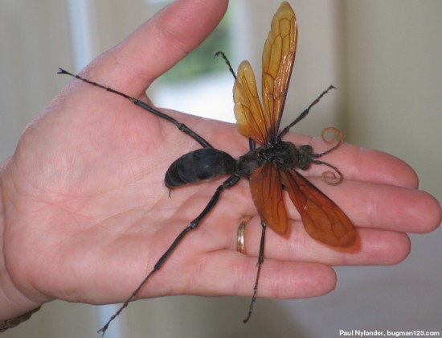
131 Tarantula hawk
Hymenoptera
Holometabolous
Chewing
Variable (Pest and Beneficial)

Slide 18
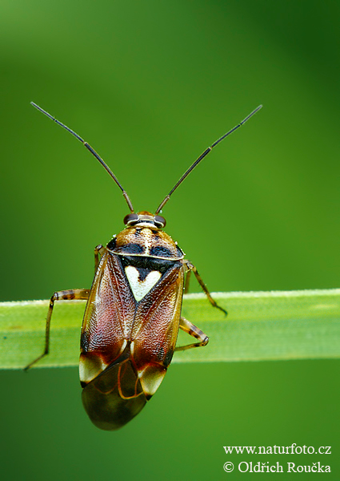
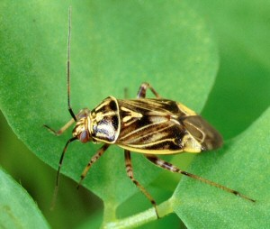
132 Tarnished plant bug
Hemiptera
Hemimetabolous
Piercing-sucking
Pest

Slide 19
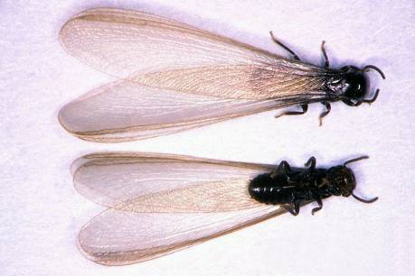
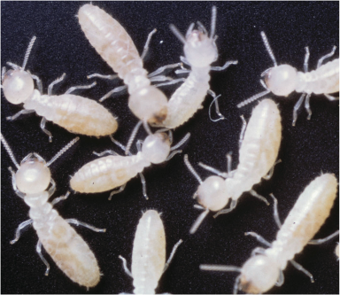
133 Termite
Isoptera
Hemimetabolous
Chewing
Variable

Slide 20
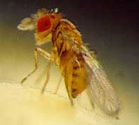
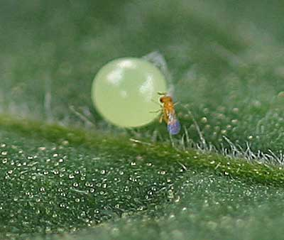
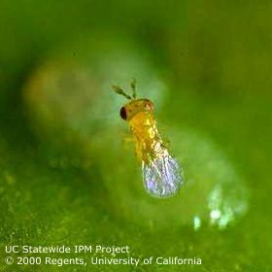
134 Trichogramma wasp
Hymenoptera
Holometabolous
Chewing
Beneficial

Slide 21
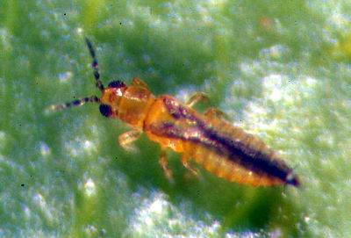
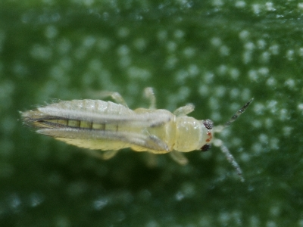
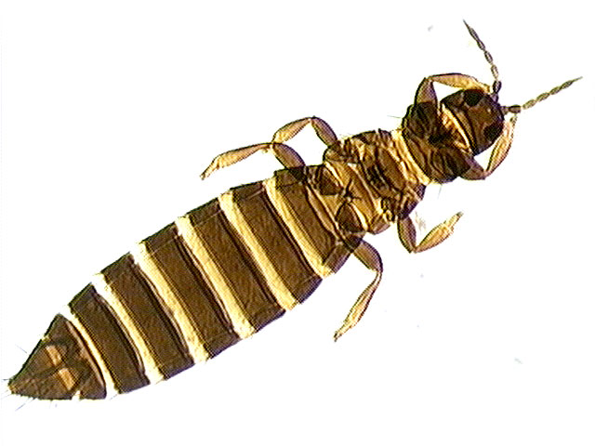
135 Thrips
Thysanoptera
Hemimetabolous
Piercing-sucking
Variable
Microscopic

Slide 22
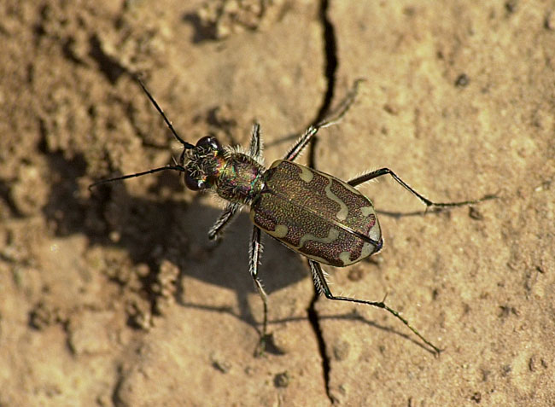
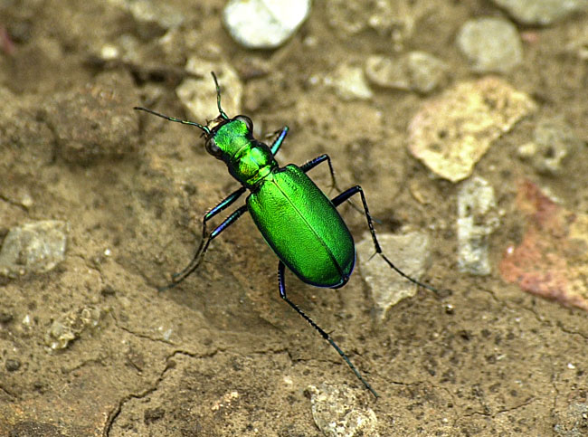
136 Tiger beetle
Coleoptera
Holometabolous
Chewing
Beneficial

Slide 23
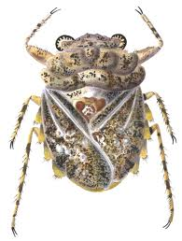
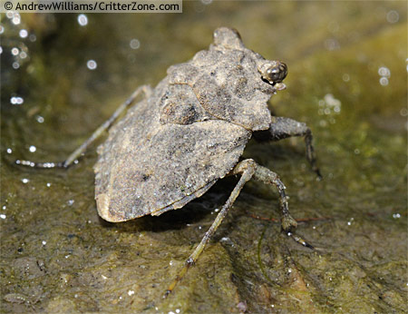
137 Toad bug
Hemiptera
Hemimetabolous
Piercing-sucking
Beneficial

Slide 24
138 Tomato hornworm
Lepidoptera
Holometabolous
Chewing
Pest
Notice the horn – will be in glass vial

Slide 25
139 Tree cricket
Orthoptera
Hemimetablolous
Chewing
Variable

Slide 26
140 Treehopper
Hemiptera
Hemimetabolous
Piercing-sucking
Pest

Slide 27
141 Tumbling flower beetle
Coleoptera
Holometabolous
Chewing
Variable
Notice Tail

Slide 28
142 Velvet ant
Hymenoptera
Holometabolous
Chewing
Variable

Slide 29
143 Viceroy butterfly
Lepidoptera
Holometabolous
Siphoning
Beneficial
Similar to Monarch but this horizontal line is not in Monarch

Slide 30
144 Vinegaroon
Non-insect
Chewing
Variable

Slide 31
145 Walkingstick
Phasmatodea
Hemimetabolous
Chewing
Variable

Slide 32
146 Water boatman
Hemiptera
hemimetabolous
Piercing-sucking
Beneficial

Slide 33
147 Water strider
Hemiptera
Hemimetabolous
Piercing-sucking
Beneficial

Slide 34
148 Whirligig beetle
Coleoptera
Holometabolous
Chewing
Beneficial

Slide 35
149 White grub
Coleoptera
Holometabolous
Chewing
Pest

Slide 36
150 Whitefly
Hemiptera
Hemimetabolous
Piercing-sucking
Pest
IN A GLASS VIAL

