Slide 1
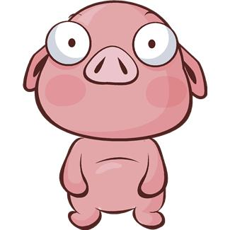
Swine Basics

Slide 2
Swine Basics page 62
Swine Facts
Types of Swine Operations:
First domesticated and raised by the ______ over _____ years ago.
#____ meat in the world.
Have _________ eyesight
A squeal can range from _____________ decibels. (A jet is _______ decibels)
Can run a ___minute mile.
Don’t ___________.
_____% of breeding is done by AI.
Farrowing:
Feeder Pig:
Finishing:
Top 5 Pork Producing States:
1.
2.
3.
4.
5.

Slide 3
Copy these terms onto page 63. Define.
Swine Terminology:
Swine:
Boar:
Barrow:
Sow:
Gilt:
Hybrid:
Hog:
Market weight:
Gestation Period:
Farrow:
Piglet:
Litter:
Farrowing Crate:

Slide 4
Swine Facts
First domesticated and raised by the Chinese over 6000 years ago
Most widely consumed meat around the world
Hogs have poor eyesight

Slide 5
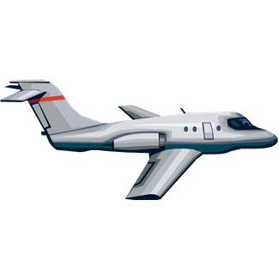
Swine Facts
A pigs squeal can range from 110-116 decibels.
A jet is about 112 decibels.

Slide 6
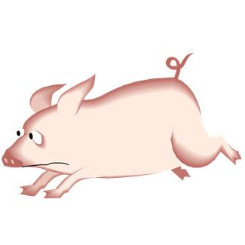
Swine Facts
A pig can run a 7 minute mile.
Pigs don’t sweat.
90% of breeding is done by AI

Slide 7
Dirty Jobs

Slide 8
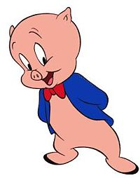
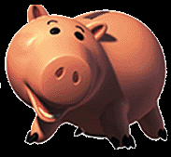
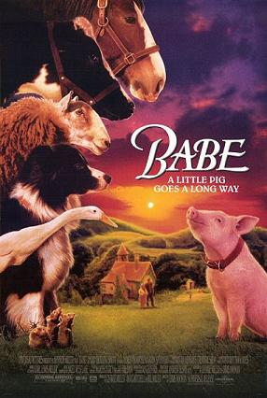
Swine
The family name for hogs

Slide 9
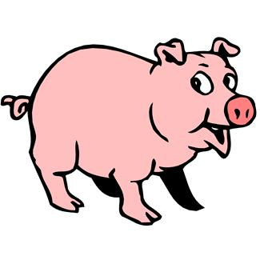
General Terms
Boar: uncastrated male swine
Barrow: castrated male swine
Sow: adult female swine
Gilt: young female swine

Slide 10
General Terms
Hybrid: Swine originating from crossing two or more breed
Hog: generic term usually applied to growing swine
Market weight: 240-250 lbs

Slide 11
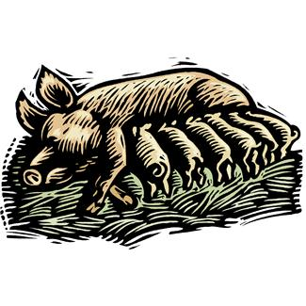
Birth Terms
Gestation period: 3 mo 3 weeks 3 days
Farrow: Process of the sow/gilt giving birth
Piglet: newborn pig
Litter: a group of piglets born at the same time to one sow
2-12 per litter

Slide 12
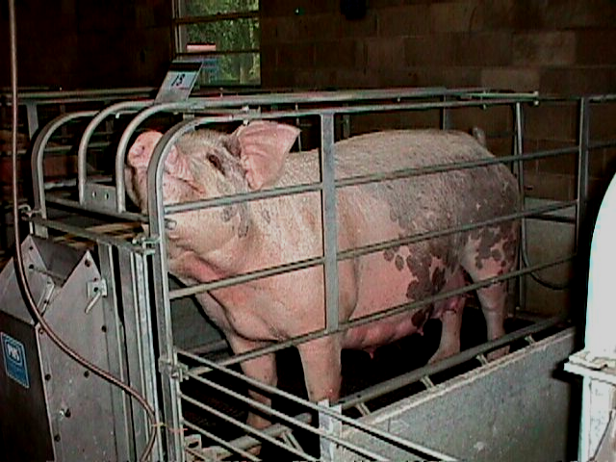
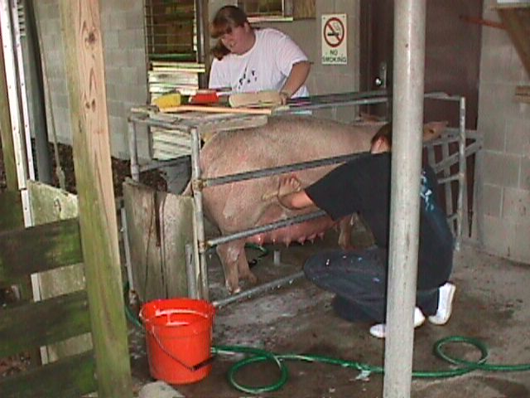
Farrowing
Farrowing stalls (crates)
protect baby pigs from being “crushed”
provides for “dual heat”
drip coolers for the sow
heat pads/lamps for baby pigs (85-95º F)

Slide 13
Farrowing Crate
Used to hold pregnant sows during farrowing and while piglets are feeding
Outlawed in some states and countries
Florida, California, Arizona
New Zealand, UK
A controversial topic in pig farming

Slide 14
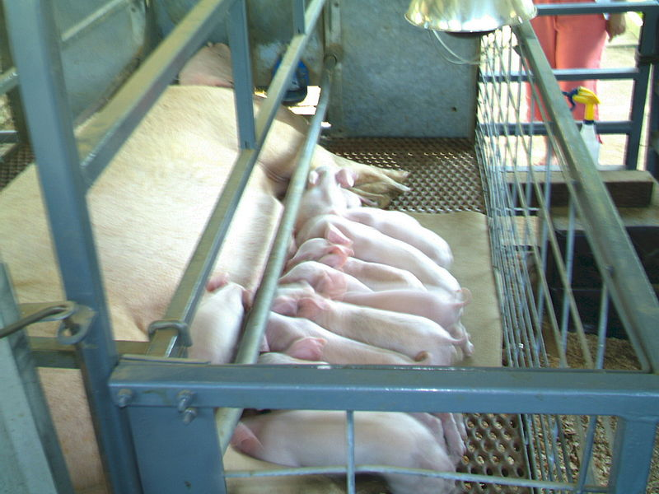
Farrowing Crate

Slide 15
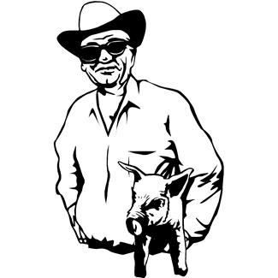
Types of Swine Operations
Farrowing: most intensive breeding system
Producer has no grow/finish floor and sells feeder pigs

Slide 16
Types of Swine Operations
Feeder Pig: breeder sells his grower pigs to a finishing operation to grow them out to market weight

Slide 17
Pig Slop Dirty Jobs

Slide 18
Types of Swine Operations
Finishing: buys feeder pigs and feeds them to 240 to 250 lbs

Slide 19
Hog Farm in Vegas

Slide 20
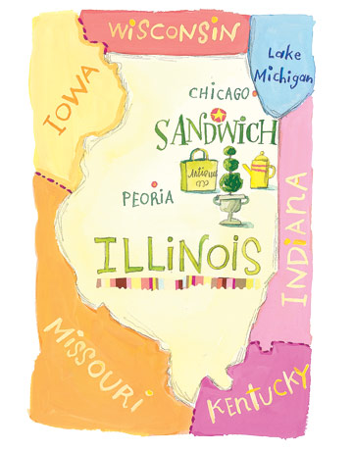
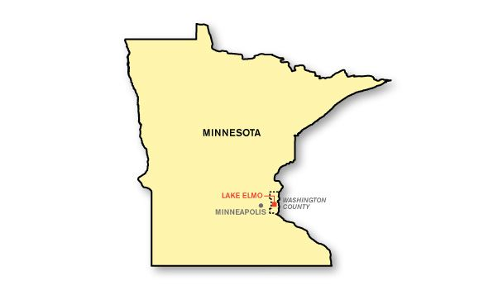
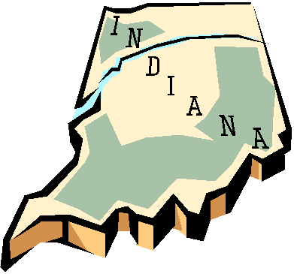
Top 5 Pig States
Iowa
North Carolina
Minnesota
Illinois
Indiana

Slide 21
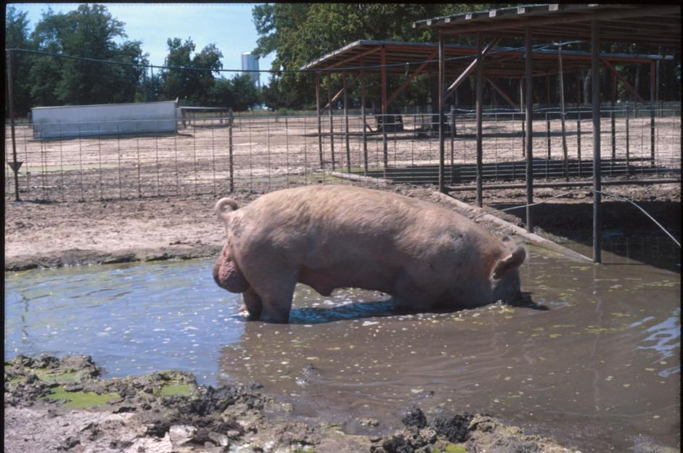
Early Production 1950’s

Slide 22
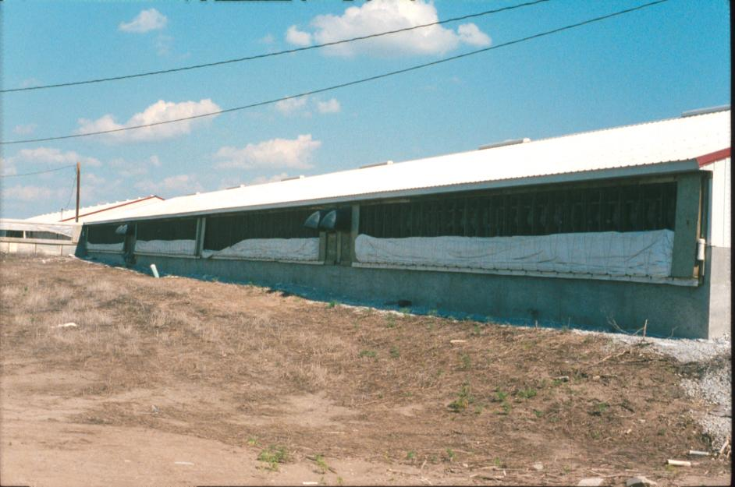
Today’s Confinement Building

Slide 23
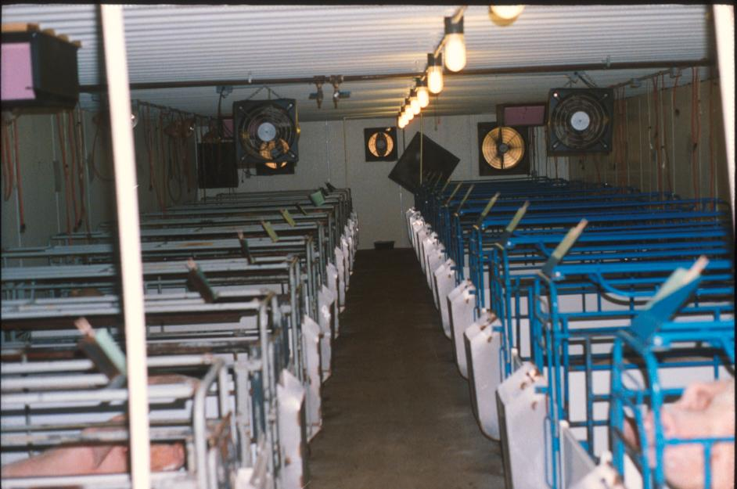
Farrowing Barn

Slide 24
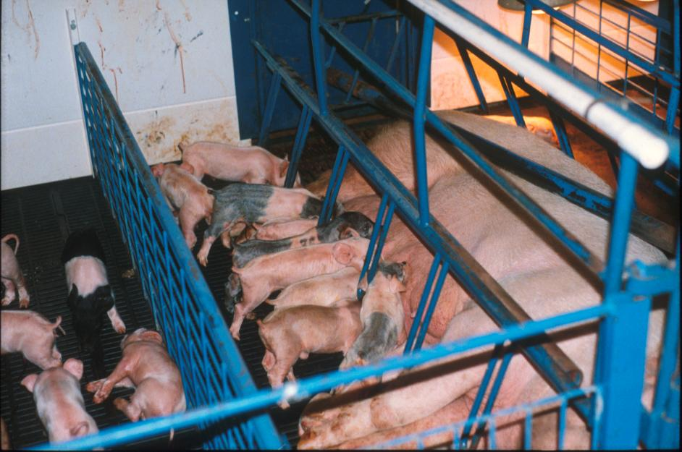
Farrowing Crate

Slide 25
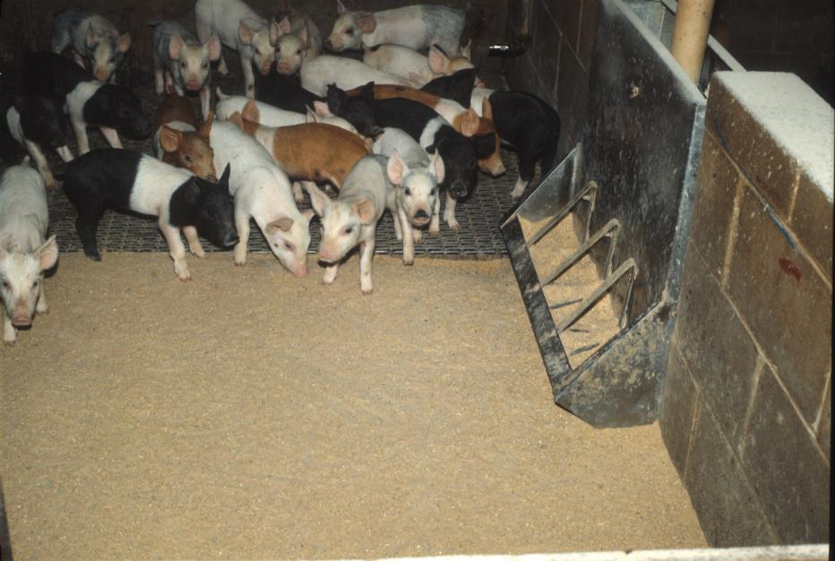
Nursery

Slide 26
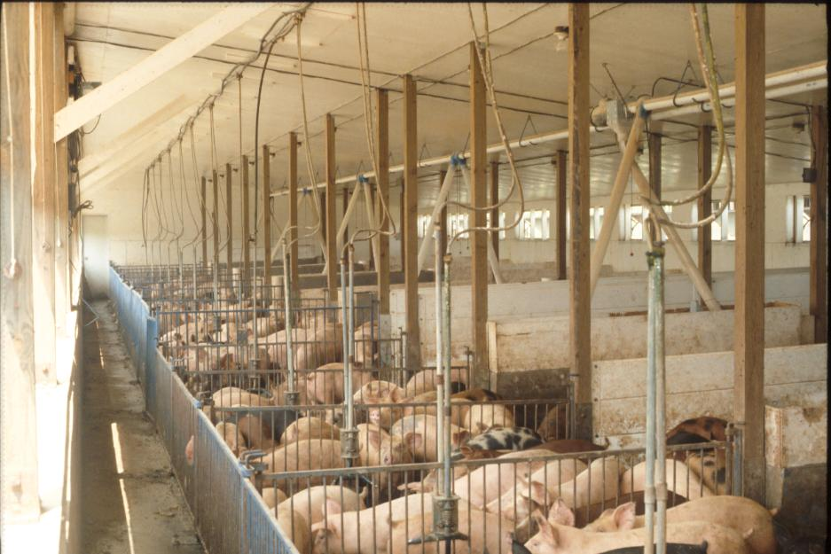
Growing - Finish

Slide 27
So where are they now?

Slide 28
Pork Products
Misc.
Insulin
Crayons
Makeup
Fertilizers
Weed killers
Shoes
Plastics
Paint
Heart valves
Food
Pork Chops
Bacon
Ham
Sausage
Hot dogs
Pork Roast

Slide 29
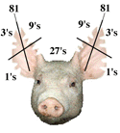
Ear Notching
Universal Swine Identification system
Tags will come off in the feed pen

Slide 30
Ear Notching

Slide 31
Ear Notching

